Slide 1
Advanced Composite Material Applications in Structural Engineering
Advances and Challenges
By
Amjad J. Aref
Professor
Structural Engineering Lecture Series – October 26, 2009

Slide 2
OUTLINE
Introduction: What are Composite Materials?
Bridge Applications
Final Remarks

Slide 3
What are Composite Materials?
Composite structures are often called fiber reinforced polymer (FRP) structures, and polymer matrix composites (PMC).
Composite materials are man-made, and must contain at least two constituents that are distinct chemically and physically.
Intended to achieve an increase in certain properties such as stiffness, strength, fracture toughness among others, or decrease certain properties such as weight and corrosion.

Slide 4
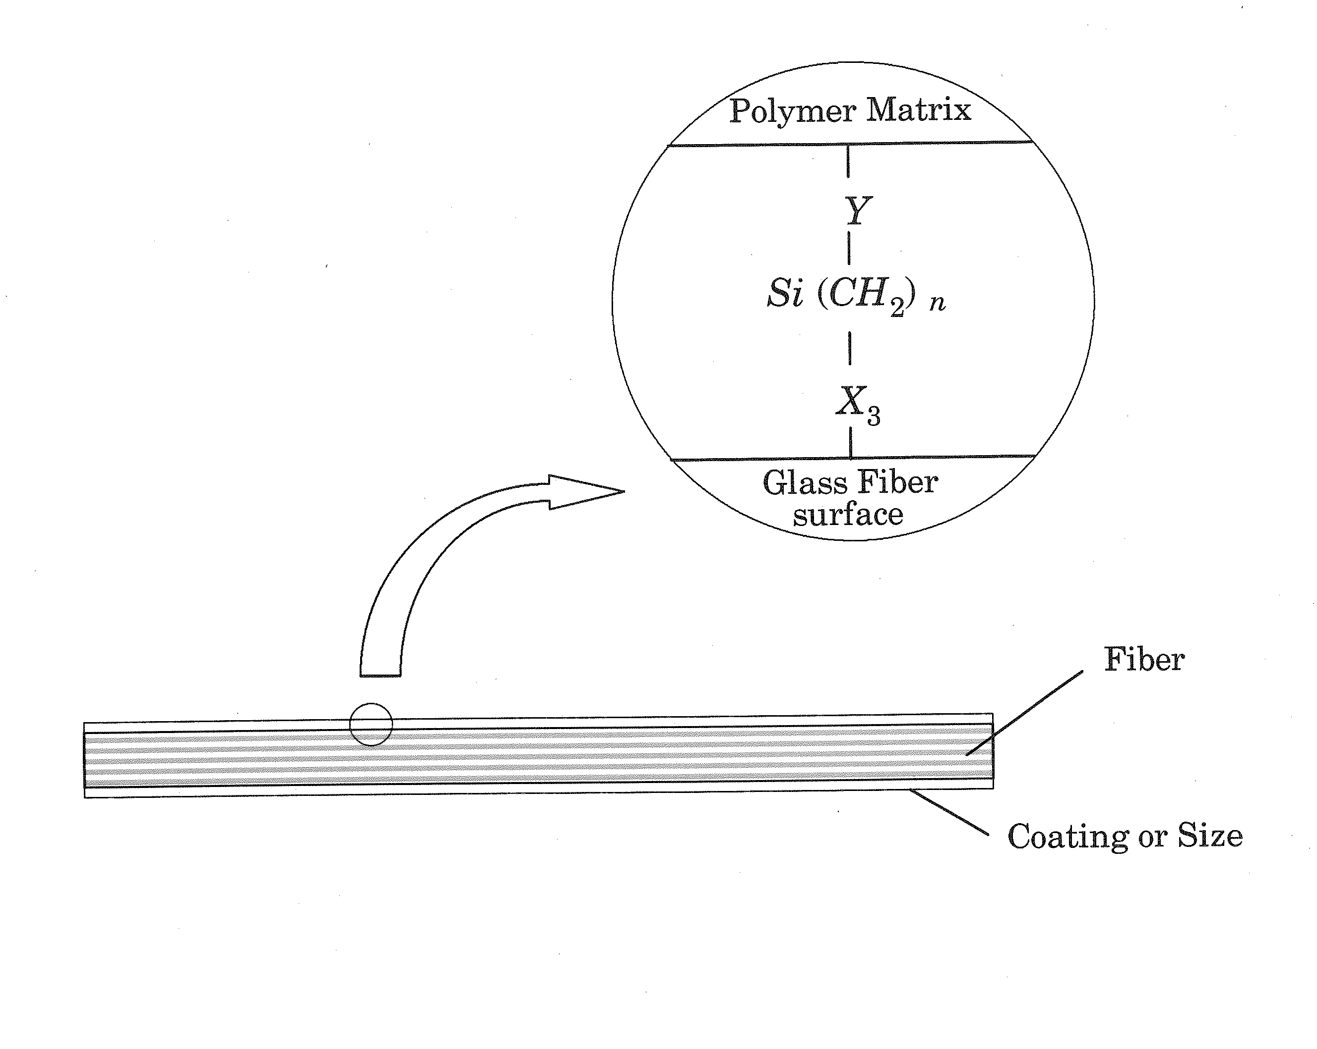
Composites Architecture
Matrix
Interface
Reinforcement

Slide 5
Reinforcement
Long continuous bundles
l/d > 10 by definition, (typical dia for a fiber ~ 6-15 µm)
unidirectional
multidirectional
woven or braided Continuous fibers
Short chopped fibers
randomly oriented
Whiskers
long thin crystals d< 1 micron length in the order of 100 microns used in ceramic matrix composites (CMC) and metal matrix composites (MMC)
Particulates
Near spherical
not usually used for strength
increase the toughness of the material
Flakes
metallic, electrical/heating applications
2-D in nature, not usually used for strength

Slide 6
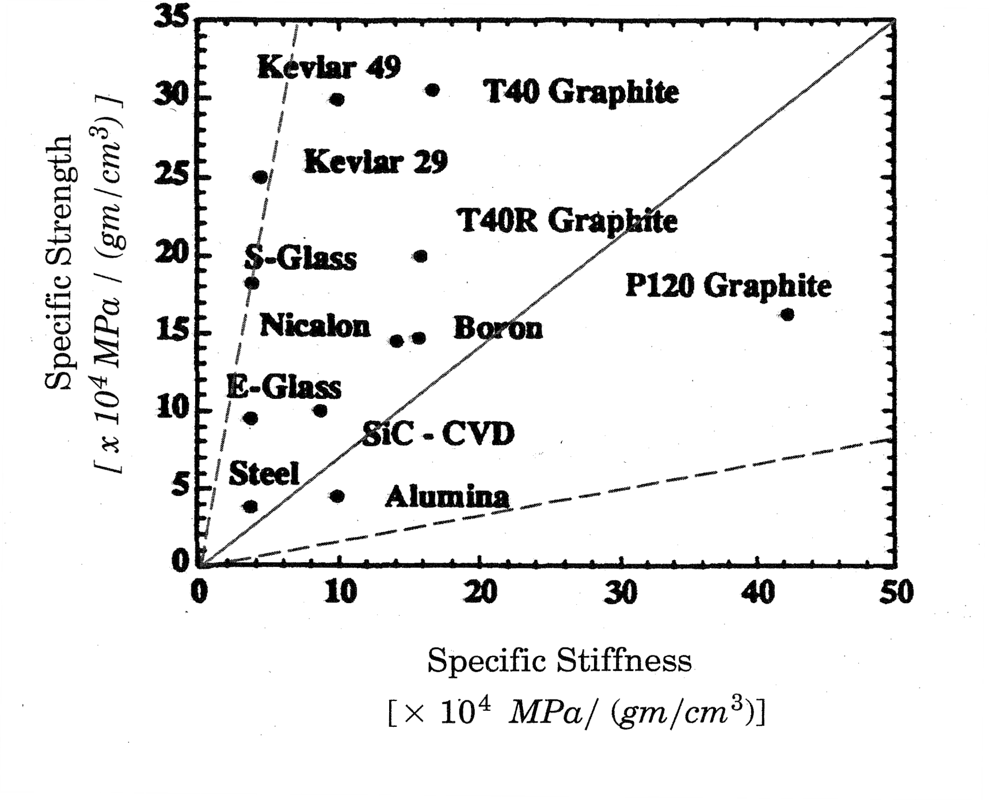
Reinforcement (cont’d)
Glass (E-, S-, C-glass fibers)
E-glass: Young’s modulus ~ 72 GPa,
σu=3450 MPa (500 ksi ), Strain to failure 1-2%
Carbon
E_{L}:250-517 GPa, E_{T}=12-20 GPa
σ_{u}=2000-2900 MPa (290-435 ksi), strain to failure 0.5-1%
Kevlar, Spectra (organic)
E: 62-131GPa
σ_{u}=2500-3790 MPa (360-550 ksi), strain to failure 2-5%
Ceramic fibers: high strength, stiffness and temperature stability
  Alumina (Al2O3)
  E: 370 GPa
  σ_{u}=1380 MPa (200 ksi)
  SiC
Boron (toxic material), typically large diameter

Slide 7
Matrix
Metallic
Ceramic
Polymeric
  Thermoplastic
  Thermoset

Slide 8
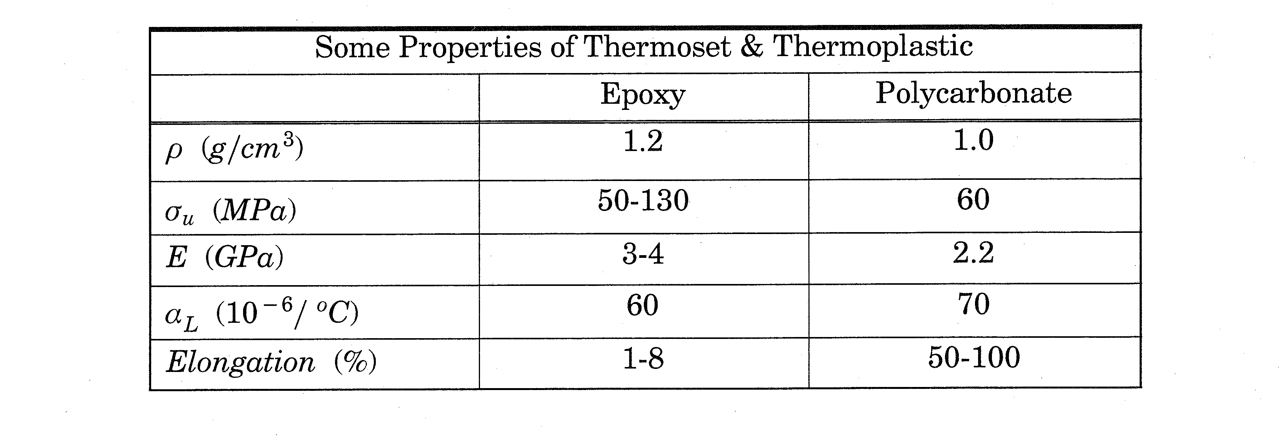
Polymer Matrix
Poly mer
Linear
Branched
Cross-linked
Network

Slide 9
Composites Categories
Reinforced Plastics
Low strength and stiffness
Inexpensive
Glass fibers is primary reinforcement
Applications:
  Boat Hulls
  Corrugated sheets
  Piping
  Automotive panels
  Sporting goods
Advanced Composites
High strength and stiffness
Expensive
High performance reinforcement such as: graphite, aramid, kevlar
Applications: Aerospace industry

Slide 10
Typical Applications in Structural Engineering
Retrofitting of beams and columns
Seismic Retrofitting
New applications
  Bridge Deck
  Bridge Superstructure

Slide 11
FRP COMPOSITES IN STRUCTURAL APPLICATIONS
Advantages
  High specific strength and stiffness
  Corrosion resistance
  Tailored properties
  Enhanced fatigue life
  Lightweight
  Ease of installation
  Lower life-cycle costs
Factors preventing FRP from being widely accepted
  High initial costs
  No specifications
  No widely accepted structural components and systems
  Insufficient data on long-term environmental durability

Slide 12
CONDITIONS OF U.S. HIGHWAY BRIDGES
28% of 590,000 public bridges are classified as “deficient”.
The annual cost to improve bridge conditions is estimated to be $10.6 billion.
Need for bridge systems that
have long-term durability and
require less maintenance
(Source: National Bridge Inventory)

Slide 13
Demand for FRP in Bridge Applications
Is it necessary to use expensive FRP materials for bridge renewal?
Given the massive investment to renew deficient bridges (28% of all bridges are deficient), repeating the same designs, materials, etc. may not be a prudent approach.
Consider the fact that the average life span of a bridge in the U.S. is 42 years.
FRP materials, if designed properly, could provide new bridges that last over 100 years.

Slide 14
GLASS FIBER REINFORCED POLYMER (GFRP) BOX SECTIONS
The compressive flange is weaker than the tensile flange.
A failure of a GFRP box section usually occurs in a catastrophic manner.
The design of a GFRP box section is usually governed by stiffness instead of strength.
Hybrid design
or
Special structural
system

Slide 15
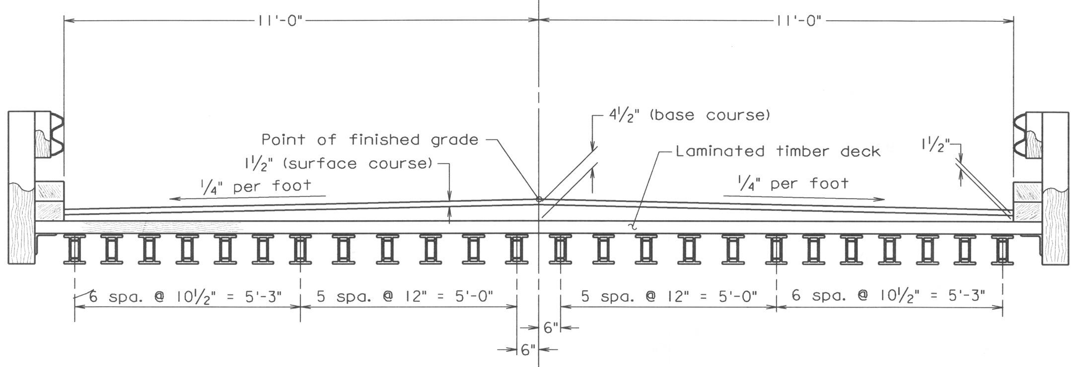
BRIDGE APPLICATIONS – 1
(TOM’S CREEK BRIDGE)
152 mm
Virginia Tech and Strongwell
Pultruded composite beam (hybrid design of glass and carbon fibers and vinyl ester matrix)
Span : 5.33 m , Width : 7.32 m
203
mm

Slide 16
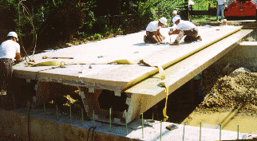
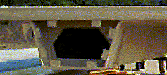
BRIDGE APPLICATIONS – 2
(TECH 21 BRIDGE)
LJB Engineers & Architects, Inc. and Martin Marietta Materials
Length : 10.1 m, Width : 7.3 m
E-glass fiber reinforcement and polyester matrix
Deck : pultruded trapezoidal tubes between two face sheets (tubes run parallel with the traffic direction)
Stringer : three U-shaped structural beams
838
mm

Slide 17
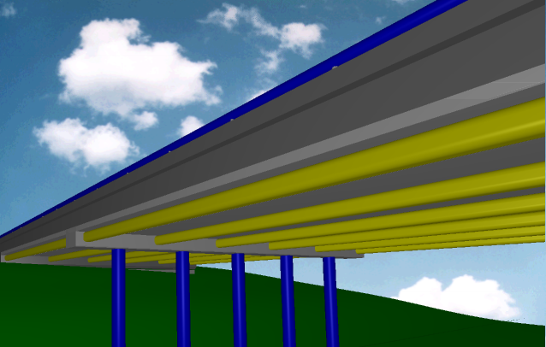
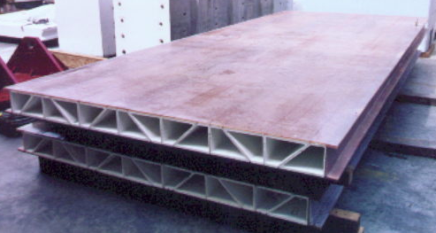
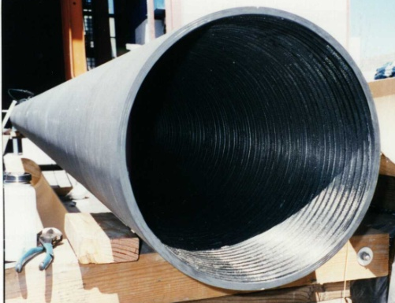
BRIDGE APPLICATIONS – 3
(KINGS STORMWATER CHANNEL BRIDGE)
UC San Diego, Alliant TechSystems, Inc., and Martin Marietta
Span: 2 x 10 m, Width: 13 m
Six longitudinal concrete filled carbon tube girders (carbon/epoxy system)
GFRP deck panel (pultruded trapezoidal E-glass/epoxy tubes with a top skin layer
Filament wound CFRP tube
GFRP deck

Slide 18
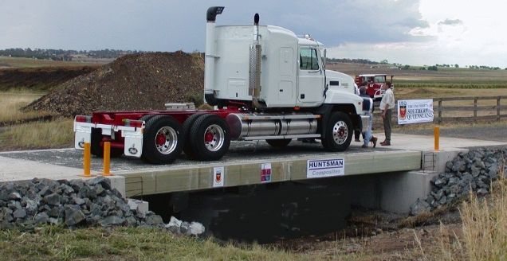
BRIDGE APPLICATIONS – 4
(TOOWOOMBA BRIDGE)
University of Southern Queensland, Wagners Composite Fibre Technologies, and Huntsman Composites
Span : 10 m, Width : 5.0 m
Hybrid box beams : prefabricated concrete, GFRP, and CFRP
concrete
100
GFRP
450
350
CFRP
(dimensions in mm)

Slide 19
MARKET SHARE (FRP COMPOSITES)

Slide 20
FRP COMPOSITE SHIPMENTS

Slide 21
Recent Development of FRP Bridge Deck and Superstructure Systems

Slide 22
Hybrid-FRP-Concrete Bridge Deck and Superstructure System
The system is developed at UB by an optimum selection of concrete and FRP.
The system is validated analytically and experimentally to assess the feasibility of the proposed hybrid bridge superstructure and deck.
Simple methods of analysis for the proposed hybrid bridge superstructure were developed.

Slide 23
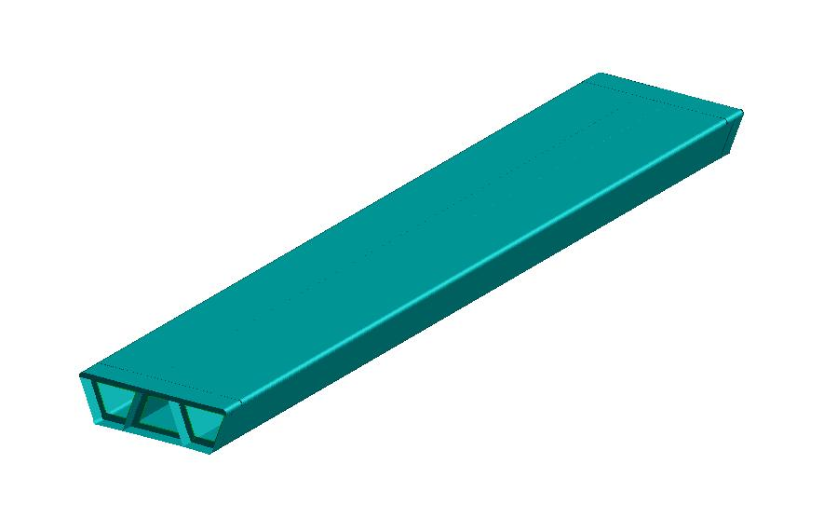
BASIC CONCEPT OF PROPOSED HYBRID FRP-CONCRETE BRIDGE
Single span with a span length of 18.3 m
AASHTO LRFD Bridge Specifications
  Live load deflection check
  d_{LL}<L/800 under (1+IM)Truck
  Service I limit
  DC+DW+Lane+(1+IM)Truck
  Strength I limit
  1.25DC+1.5DW+1.75[Lane+(1+IM)Truck]
Concrete should fail first in flexure.
A strength reduction factor for GFRP was taken as 0.4.
18288 mm
3785 mm
99mm
1160
mm
Simple-span one-lane hybrid bridge

Slide 24
PROPOSED HYBRID BRIDGE SUPERSTRUCTURE
Advantages include:
  Increase in stiffness
  Corrosion resistance
  Cost-effectiveness
  Lightweight
  Local deformation reduction
  High torsional rigidity
  Pre-fabrication
  Short construction period

Slide 25
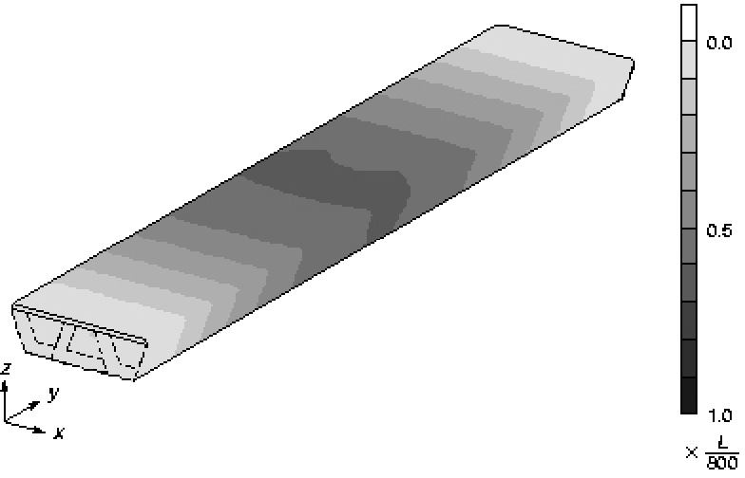
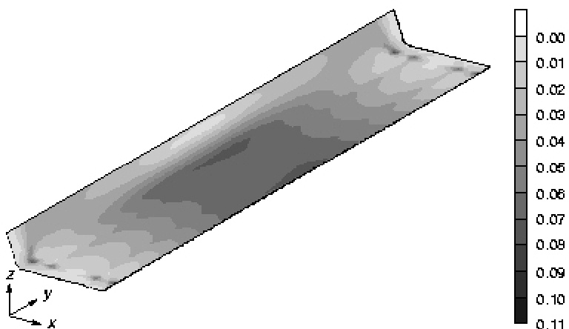
DISPLACEMENT AND STRENGTH CHECKS
Deflection check: 0.61 x L/800
Max. failure index : 0.107 (safety factor=3.1)
(a) Live load deflection check
(b) Tsai-Hill Failure index
under Strength I limit

Slide 26
TSAI-HILL FAILURE INDEX
Failure condition :
where
Strengths in the principal 1 and 2 directions and in-plane shear
Tensile and compressive directions

Slide 27
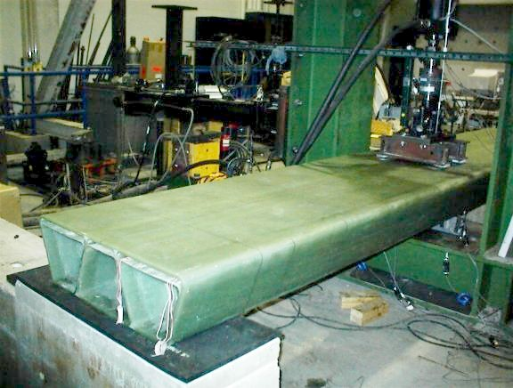
EXPERIMENTAL PROGRAM
Materials
  GFRP
  Concrete
Non-destructive tests
  Flexure
  Off-axis flexure
Fatigue test
Destructive tests
  Flexure
  Shear
  Bearing

Slide 28
TEST SPECIMEN
One-fifth scale model
Span length = 3658 mm
(dimensions in mm)

Slide 29
STACKING SEQUENCES
Thickness of one layer = 0.33-0.40 mm

Slide 30
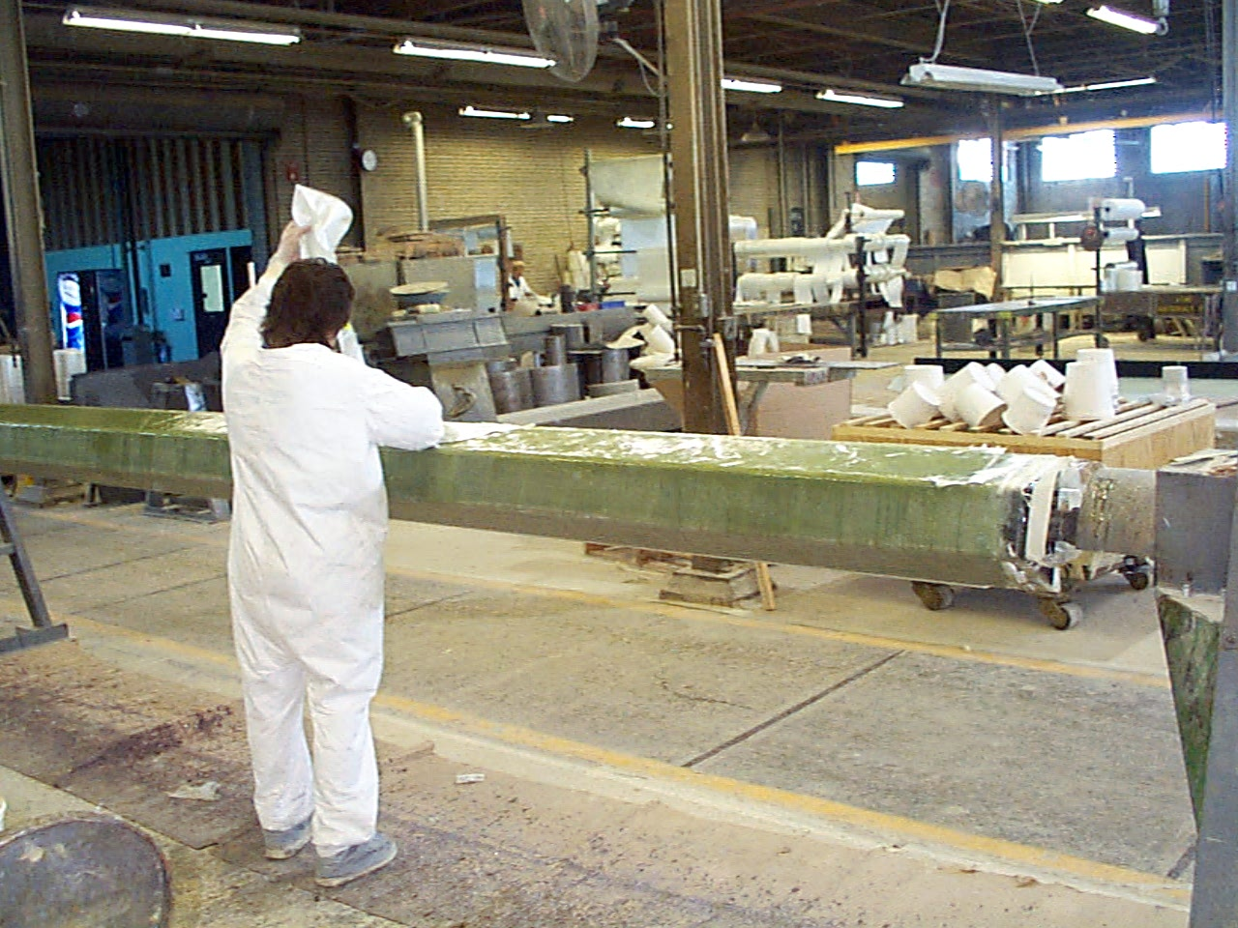
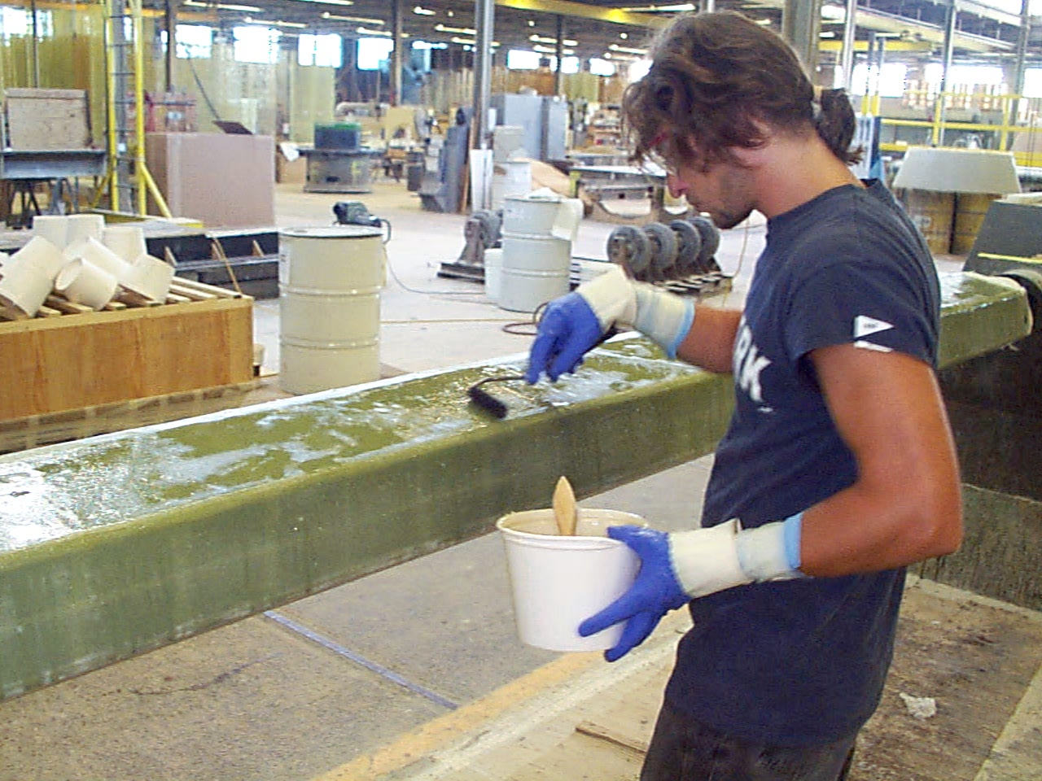
FABRICATION – 1

Slide 31
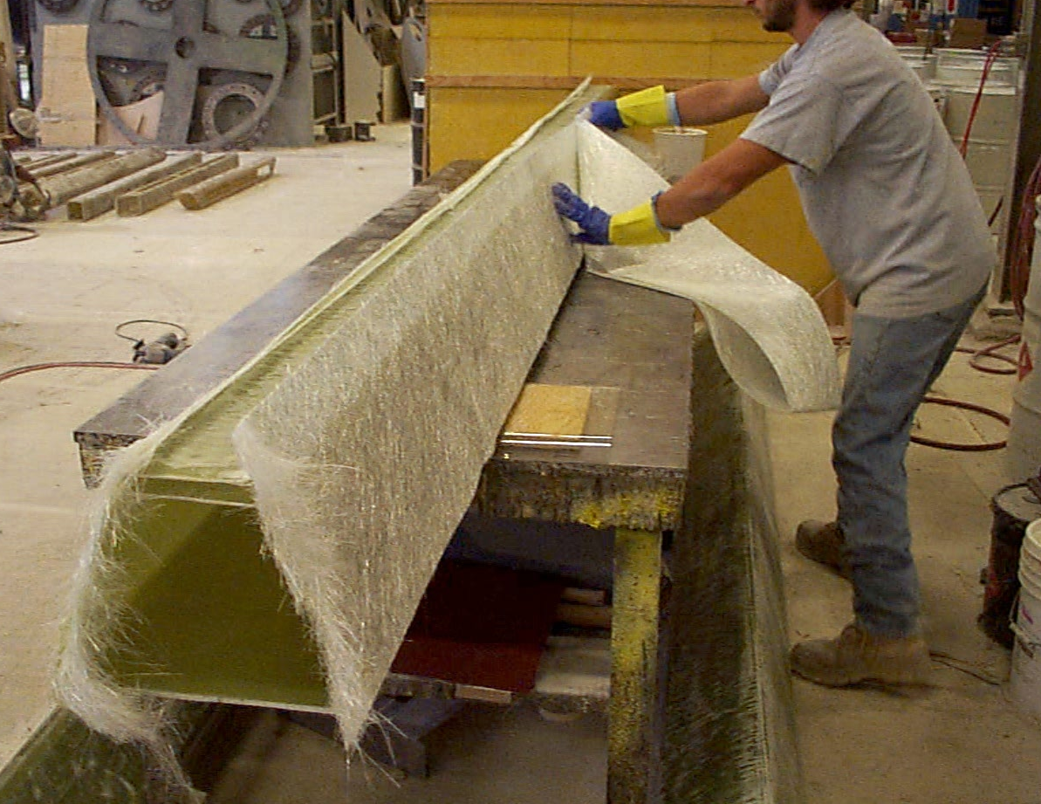
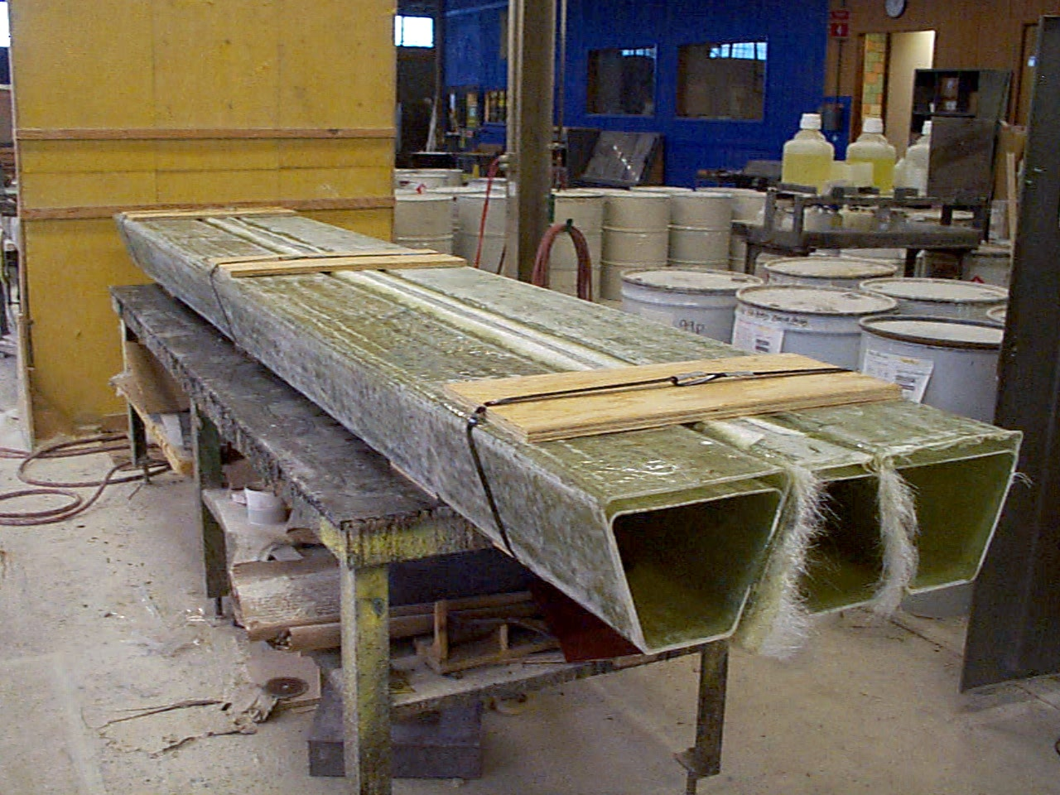
FABRICATION – 2

Slide 32
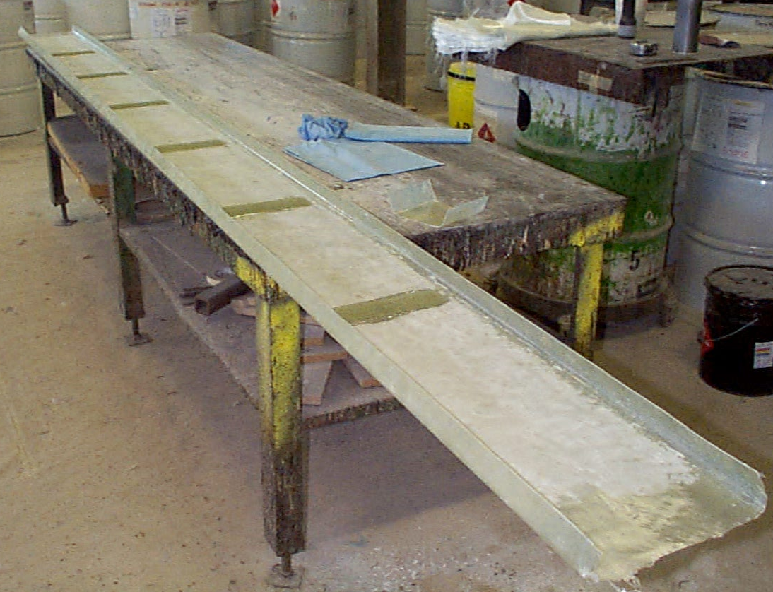
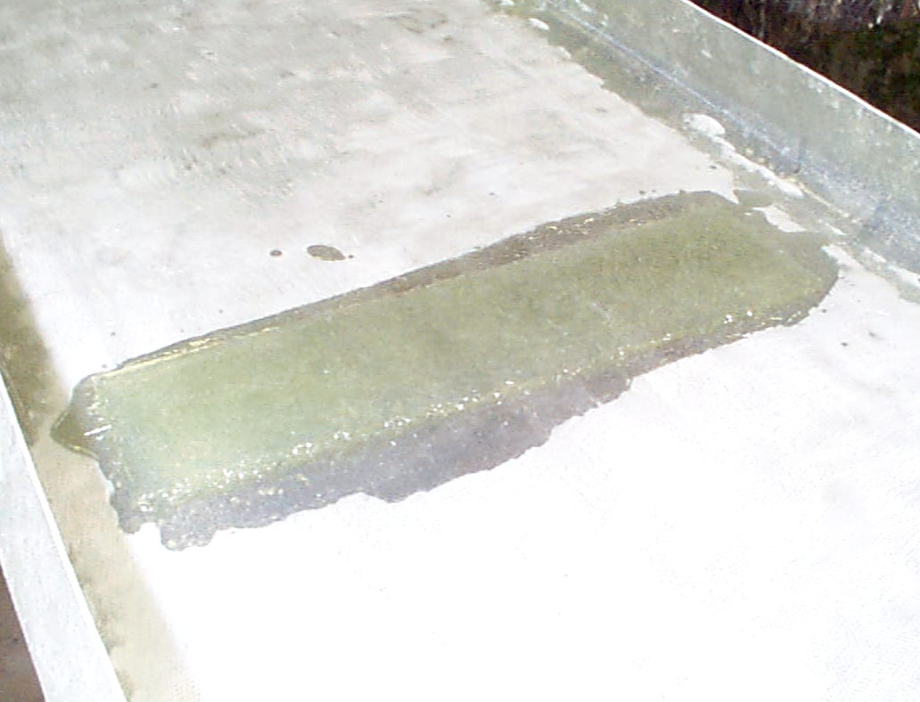
SHEAR KEYS
Shear keys
(dimensions in mm)
Longitudinal direction

Slide 33
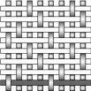
MATERIALS – GFRP
Warp
E-glass woven fabric reinforcement
  Cheaper than carbon fiber reinforcement
  Impact resistance
Vinyl ester
  High durability
  Extremely high corrosion resistance
  Thermal stability
Fill
Material Properties
Test | Dir. | E or G (GPa) | ν | Strength (MPa)
Tens | Fill | 16.6 | 0.129 | 285
 | Warp | 17.9 | 0.131 | 335
Comp | Fill | 15.9 | 0.099 | -241
 | Warp | 22.5 | 0.254 | -265
Shear | Fill | 2.72 | -- | 56.1
 | Warp | 2.45 | -- | 63.8

Slide 34
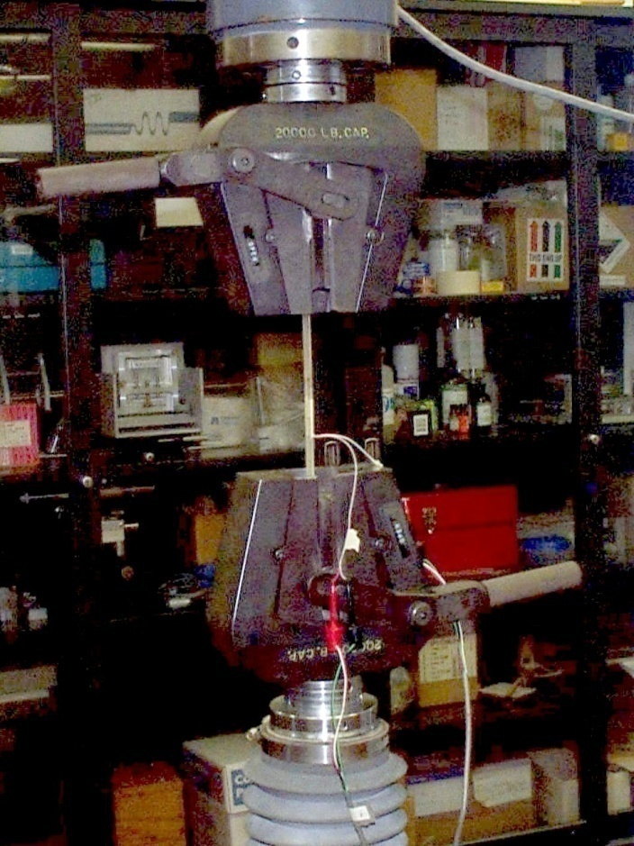
GFRP – TENSION

Slide 35
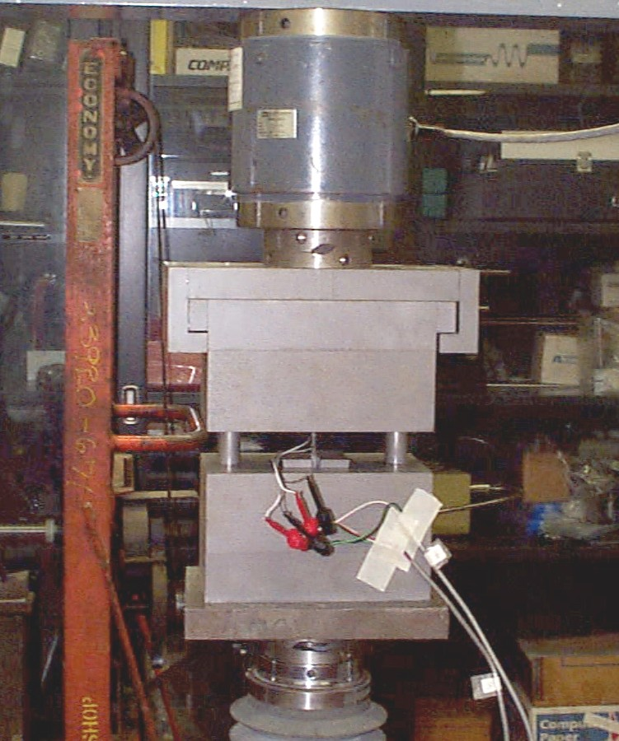
GFRP – COMPRESSION

Slide 36
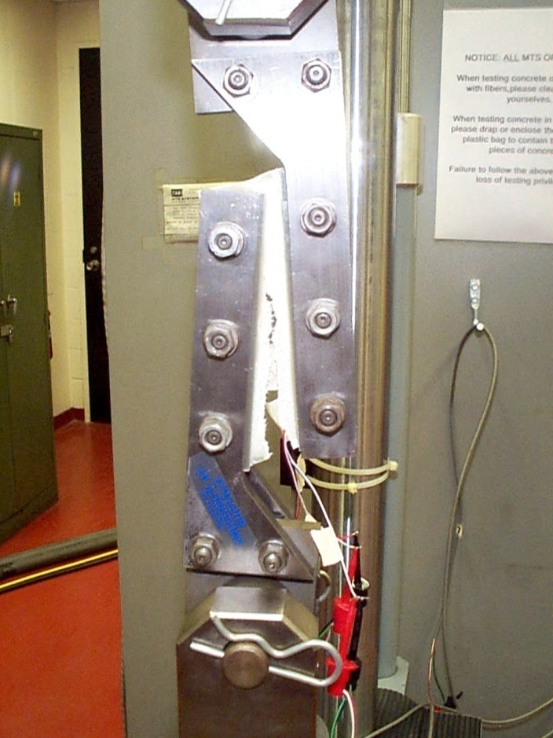
GFRP – SHEAR

Slide 37
MATERIALS - CONCRETE
No coarse aggregates
water : cement : aggregate = 0.46 : 1.0 : 3.4 by weight
Compressive Properties
Young’s Modulus (GPa) | Strength (MPa)
8.38 | 37.9

Slide 38
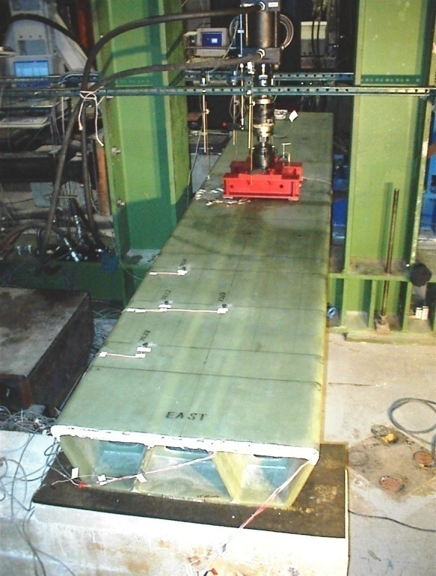
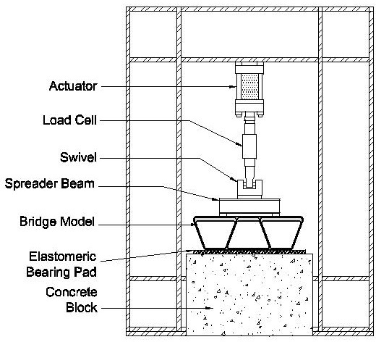
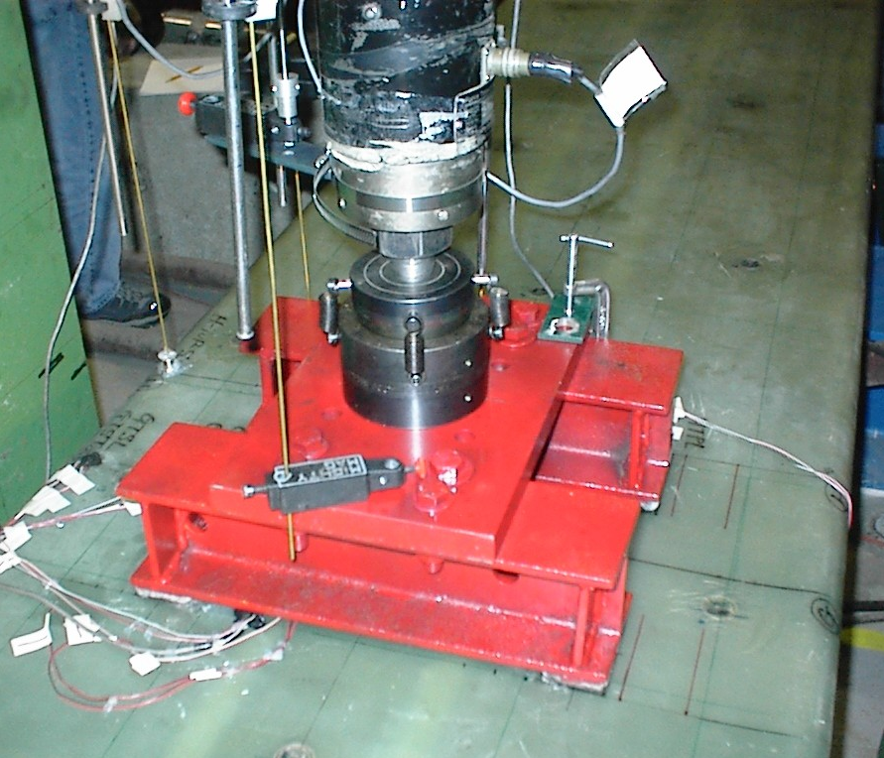
TEST SETUP

Slide 39
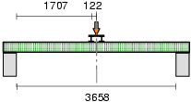
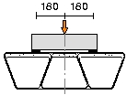
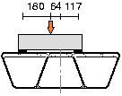
FLEXURAL LOADING CONFIGURATION
(dimensions in mm)
(a) Elevation
(b) Cross section
(flexure)
(c) Cross section
(off-axis flexure)

Slide 40
NONDESTRUCTIVE FLEXURE (TEST PROTOCOL)
To examine elastic behavior of the bridge under the flexural loading
Displacement control
Max applied displ. = L/480 (L: span length)

Slide 41
NONDESTRUCTIVE FLEXURE (FORCE-DISPLACEMENT)
19% increase
40% for the prototype

Slide 42
NONDESTRUCTIVE FLEXURE (TOP SURFACE DEFORMATION)

Slide 43
NONDESTRUCTIVE FLEXURE (STRAIN RESULTS)
Bottom surface
along the center-line
(b) Exterior web over height

Slide 44
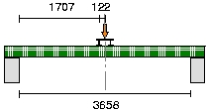
FATIGUE LOADING (TEST PROTOCOL)
To examine fatigue characteristics
Flexural loading
Force control
2 x 10⁶ cycles
Freq.= 3.0 Hz
Max. load = 2.0 x Tandem
Stiffness evaluation every 0.2 million cycles

Slide 45
FATIGUE LOADING (TEST RESULTS)

Slide 46
DESTRUCTIVE FLEXURE (TEST PROTOCOL)
To examine the strength of the bridge and failure modes
Flexural loading
Displacement control
Two stages
  Step I (displacement history #1)
  Step II (displacement history #2)
(a) Displacement history #1
(b) Displacement history #2

Slide 47
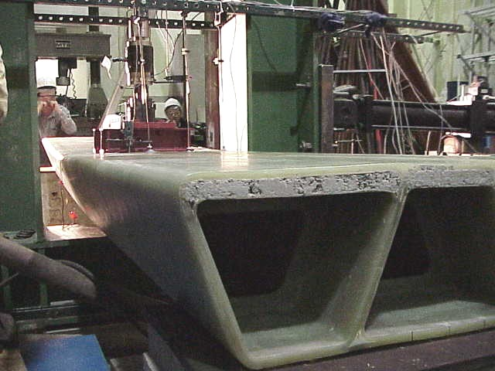
DESTRUCTIVE FLEXURE (TEST RESULTS – 1)
Failure load = 35 x Tandem load
global
local

Slide 48
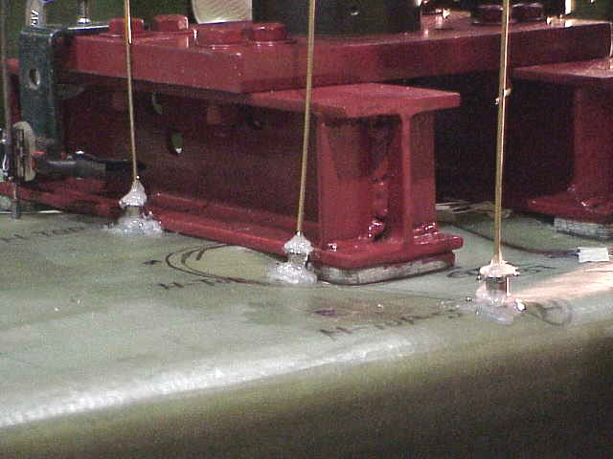
CHANGE OF A LOADING CONDITION
From four point loads to two line loads
contact

Slide 49
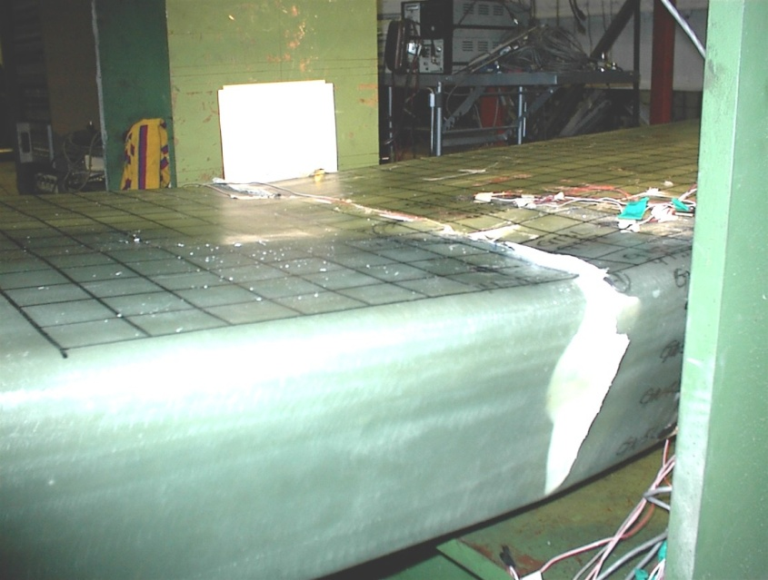
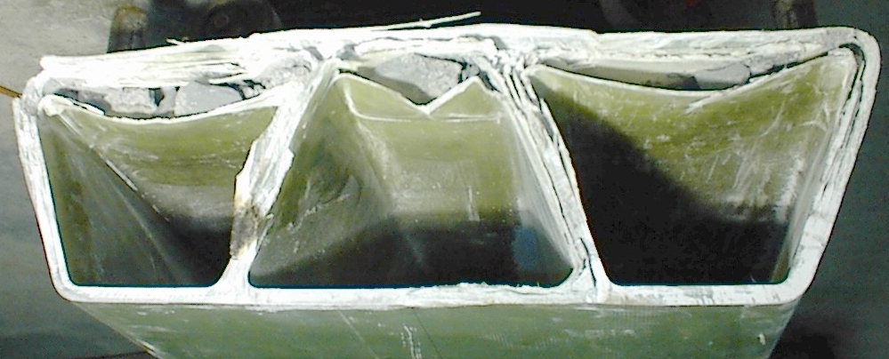
DESTRUCTIVE FLEXURE (TEST RESULTS – 2)
Failure modes
  Concrete crushing
  Failure of GFRP in compression

Slide 50
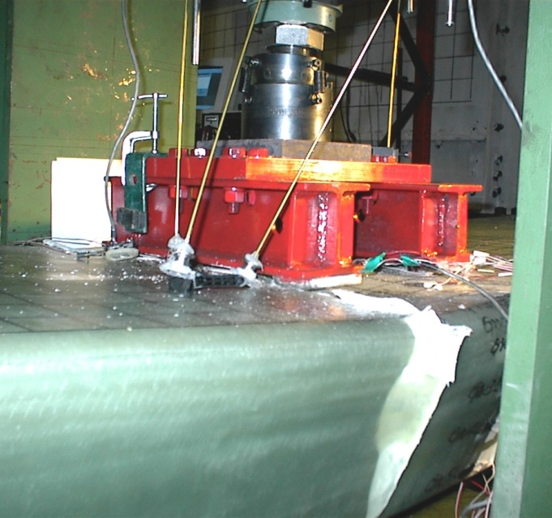
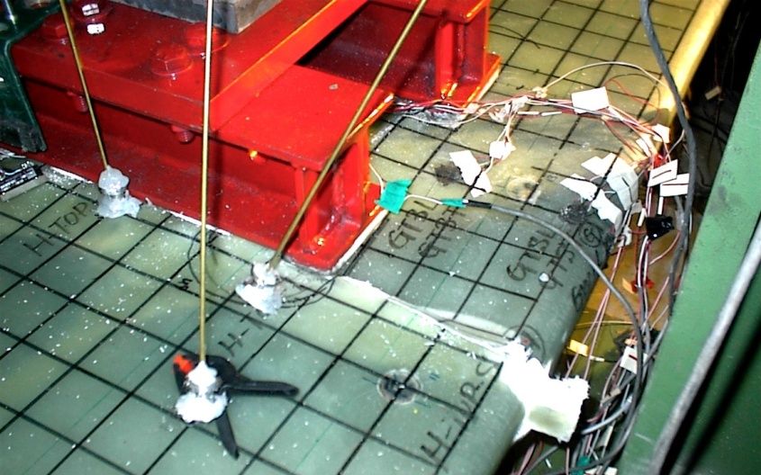
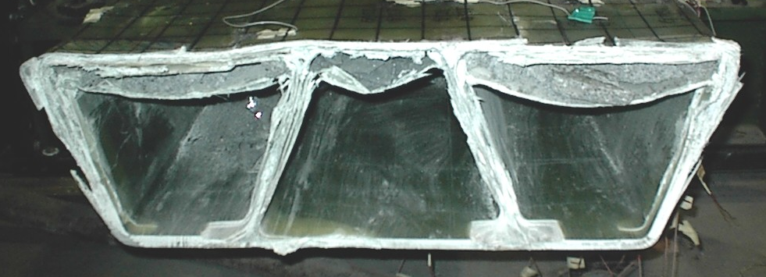
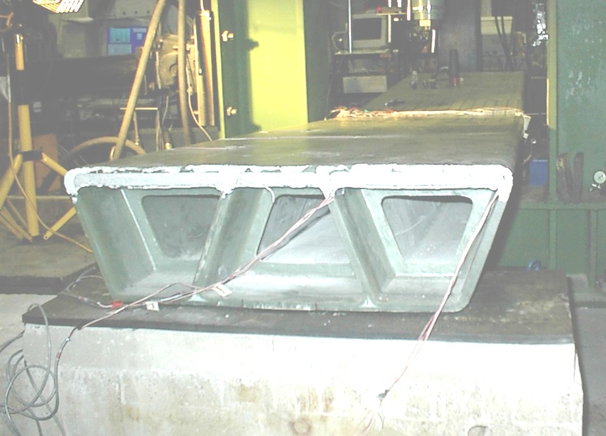
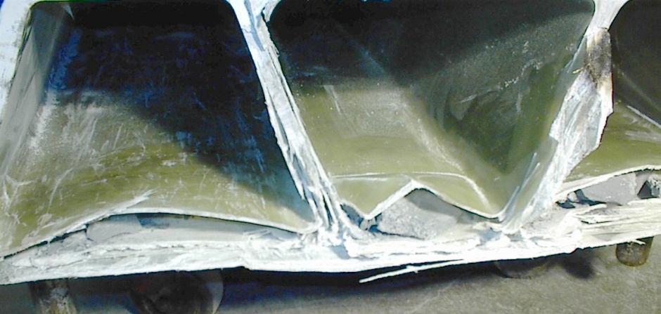
DESTRUCTIVE FLEXURE
(FAILURE MODES)

Slide 51
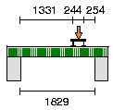
SHEAR TEST

Slide 52
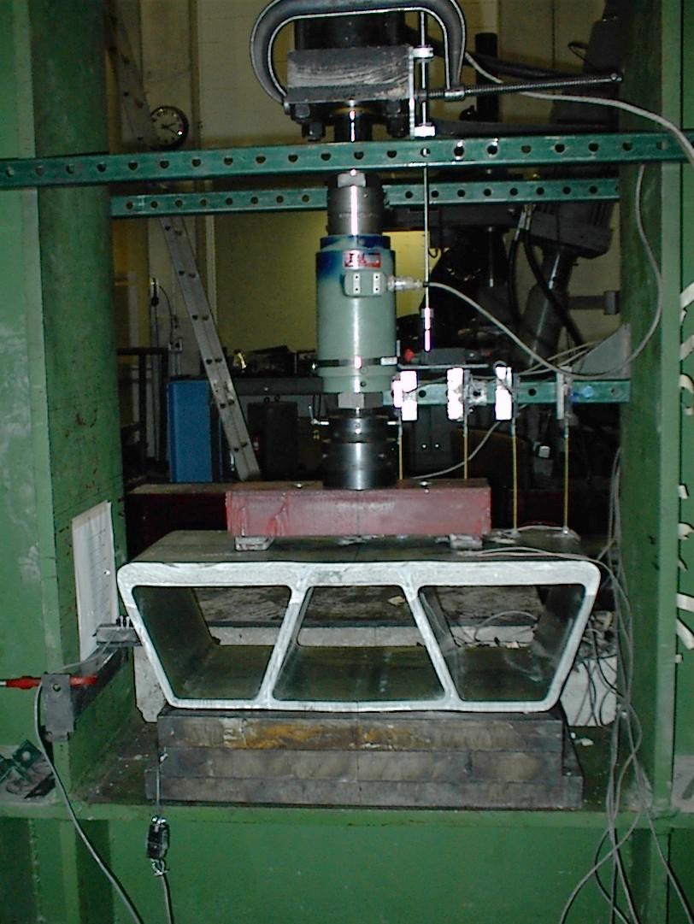
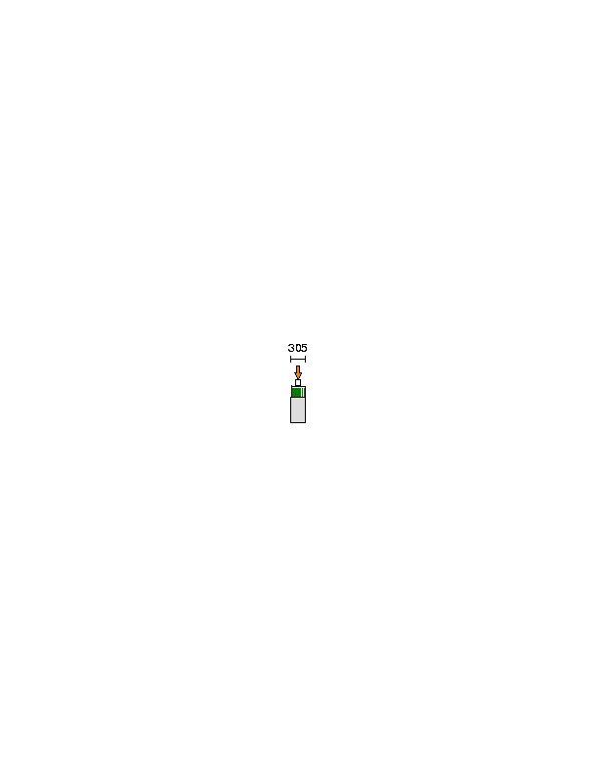
BEARING TEST

Slide 53
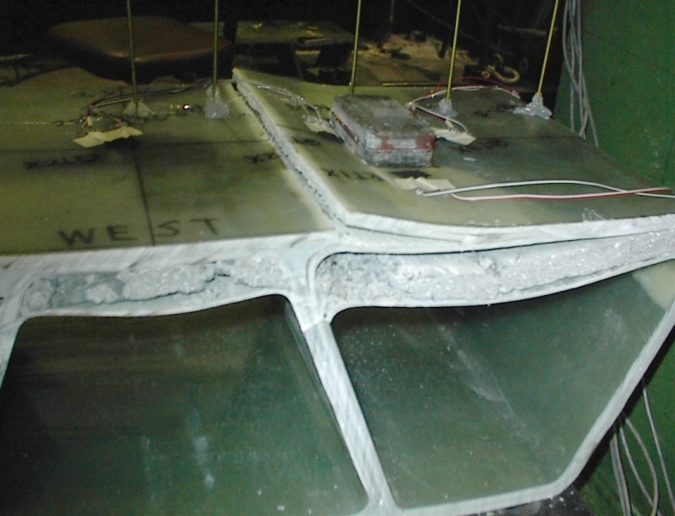
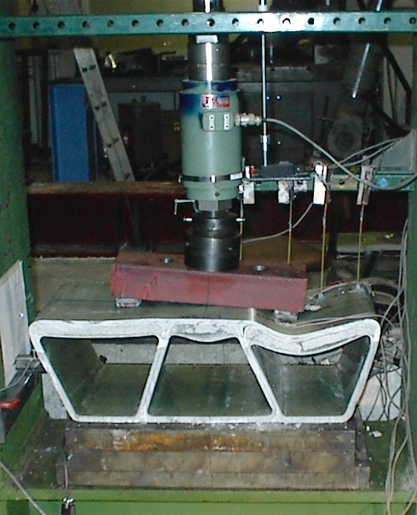
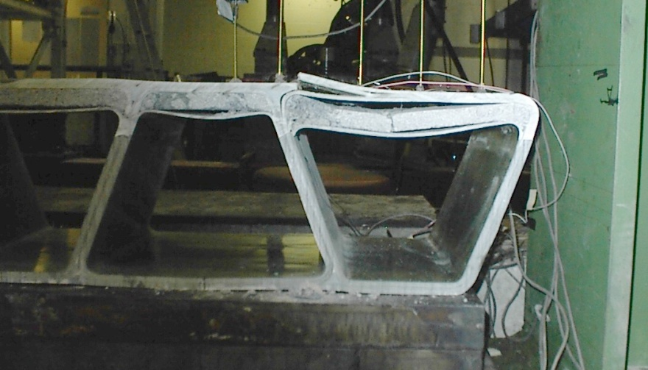
BEARING TEST
(FAILURE MODE)

Slide 54
FINITE ELEMENT ANALYSIS
ABAQUS
Four-noded general shell element, S4R, for GFRP laminates
Eight-noded general 3D solid element, C3D8, for concrete
Assumed a perfect bonding between concrete and GFRP
Linear analysis
Nonlinear analysis

Slide 55
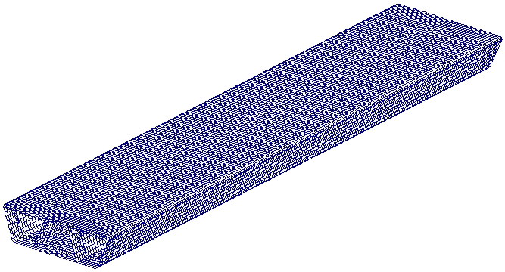
FINITE ELEMENT DISCRITIZATION (LINEAR ANALYSIS)
Number of nodes: 31,857
Number of elements: 38,892 (22,764 for S4R and 16,128 for C3D8)

Slide 56
LINEAR FEA RESULTS
(FLEXURE – 1)
Stiffness was predicted by FEA within 5% error.

Slide 57
LINEAR FEA RESULTS
(FLEXURE – 2)
(a) Top surface
(b) Bottom surface

Slide 58
LINEAR FEA RESULTS
(FLEXURE – 3)
Bottom surface
along the center-line
(b) Exterior web over height

Slide 59
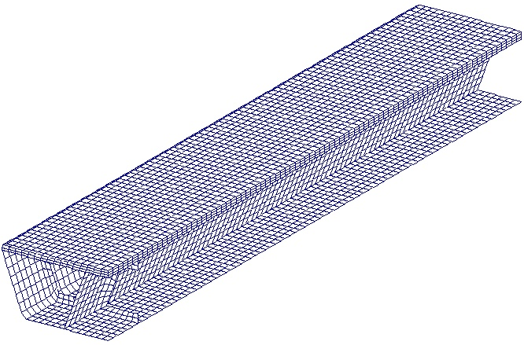
FINITE ELEMENT DISCRETIZATION (NONLINEAR ANALYSIS)
A quarter model
y
Loading
point
x

Slide 60
NONLINEAR FEA RESULTS – 1

Slide 61

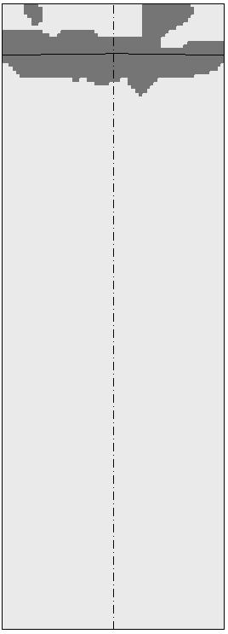
NONLINEAR FEA RESULTS – 2 (DAMAGED AREA)
y
y
failure section
y
y
x
x
x
x
(a) FEA
(b) Experiment

Slide 62
SIMPLE METHODS OF ANALYSIS
Simple methods
  Beam analysis
  Orthotropic plate analysis
Classical lamination theory
Use of effective engineering properties of laminates
Perfect bonding between concrete and GFRP was assumed.
Shear deformation was neglected
Primary objective is to obtain deflection under design loads.

Slide 63
BEAM ANALYSIS
The bridge is modeled as a beam with a span length, L, effective flexural rigidity, EI_{eff}, and effective torsional rigidity, GJ_{eff}.
where
Effective modulus
Effective shear modulus
Vertical coord. from the neutral axis
Area enclosed by median lines of the top and bot. flanges and exterior webs
Axis along the median line of a component

Slide 64
ORTHOTROPIC PLATE ANALYSIS
The bridge is modeled as an orthotropic plate with span length of L and width of W.
where
Vertical displacement
Distributed load on the plate
Rigidities that can be obtained by using the classical lamination theory

Slide 65
REPRESENTATIVE UNITS
FOR THE PLATE ANALYSIS
(a) Longitudinal direction
(b) Transverse direction

Slide 66
SIMPLE METHODS OF ANALYSIS (UNDER TANDEM LOAD ONLY)
(a) Transverse direction
(b) Longitudinal direction

Slide 67
Summary
Composite materials hold great promise for effective renewal of deficient bridges.
The hybrid FRP-concrete bridge superstructure is highly feasible from the structural engineering point of view.
GFRP used in this study has revealed that its stress-strain relationship is not perfectly linear-elastic. However, for design purposes, the equivalent linear model can be used.

Slide 68
Summary (CONT’D)
As is often the case with all-composite bridges, the design of the hybrid bridge superstructure is also stiffness driven.
Results from a series of quasi-static tests have shown an excellent performance of the proposed hybrid bridge under live loads.
The beam and orthotropic plate simplified analyses have proven to be effective to accurately predict the deflection of the hybrid bridge under design loads.

Slide 69
Challenges
A systematic way to determine design parameters should be developed. It is also important to propose and optimize the design based on life-cycle cost as well as performance.
Long-term performance of FRP bridges is not yet established and should be investigated:
creep, fatigue, and material degradation.
Thermal effects on FRP bridges is still unknown and should be investigated.
Quality control concerns— the material properties are highly dependent on the manufacturing process.

Slide 70
Challenges (CONT’D)
Several practical aspects of FRP applications in bridges need to be addressed by researchers. The following are some of the outstanding issues:
  Methods to expand lanes
  Methods to cast concrete
  Considerations for negative moments
  Concrete barrier or steel parapet
  Support conditions

Slide 71
Challenges (CONT’D)
There are benefits in using light FRP deck or superstructure in bridges located in moderate and seismic regions.
Automated fabrication process must be used to fabricate the FRP parts of the superstructure or deck.

Slide 72
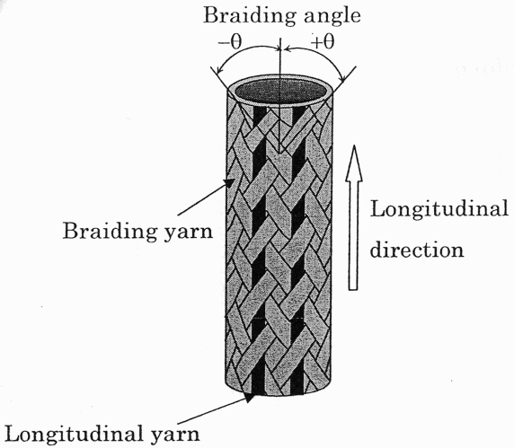

AUTOMATED FABRICATION PROCESSES
Pultrusion
RTM
VARTM
Use of braided fabrics
Filament Winding

Slide 73
Acknowledgment
Dr. Y. Kitane
Dr. W. Alnahhal
New York State Department of Transportation

Slide 74

THANK YOU

