Slide 1

Assessment of Lead-Rubber Bearings in Bridges: Application of Nonlinear Model Based System Identification
IL-SANG AHN, Ph.D.
Research Scientist
Department of Civil, Structural and Environmental Engineering
University at Buffalo

Slide 2
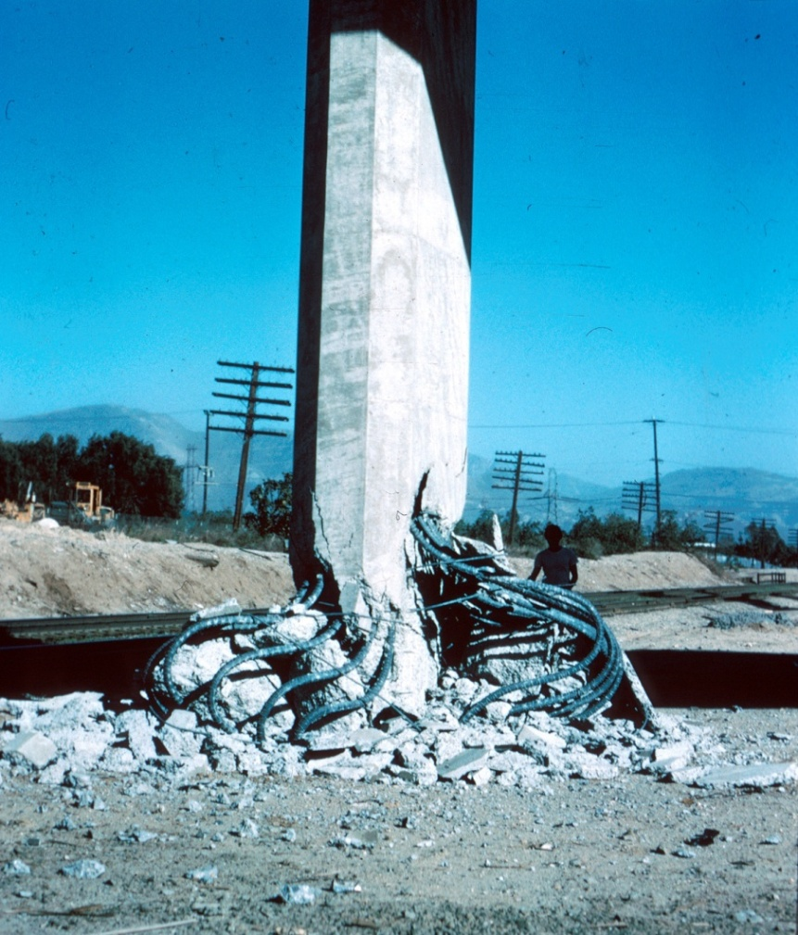
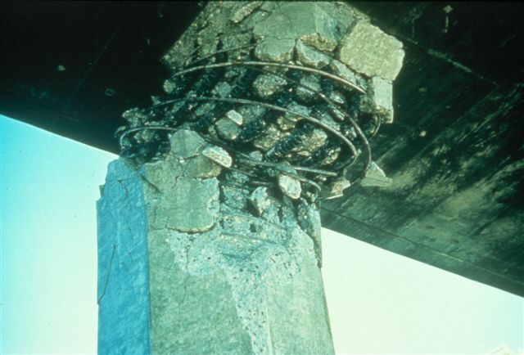
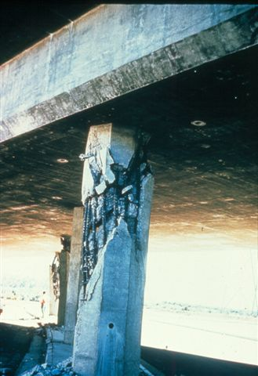
Column Damages from Earthquakes
San Fernando (2/9/1971) M6.6

Slide 3
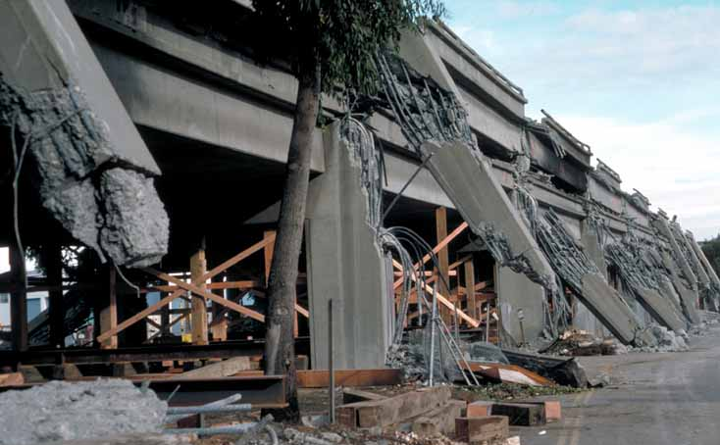
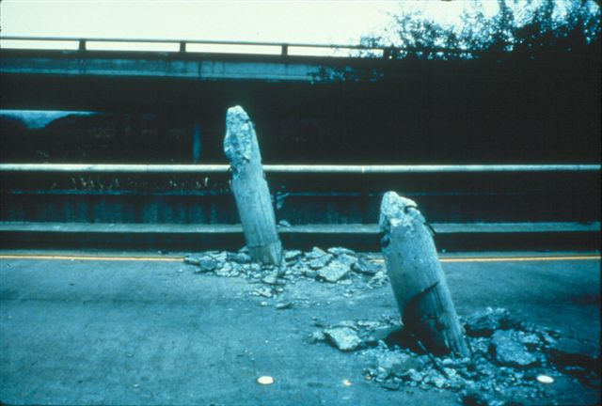
Column Damages from Earthquakes
Loma Prieta (10/17/1989) M7.1
Notes:
The upper bridge was a part of the Cypress Freeway in Oakland, California. The upper deck of this two story viaduct was collapsed into the lower deck due to failure of multicolumn bents. There were pinned connection in the columns at the top of the lower deck. Those pinned connections did not contain enough confinement or sufficient development length in connecting reinforcement rebar.
The lower bridge was the Struve Slough bridge where columns punched through the concrete deck. The weak clay at the site was experienced large displacements that dragged foundations and columns out from the bridge superstructure which resulted in this failure.

Slide 4
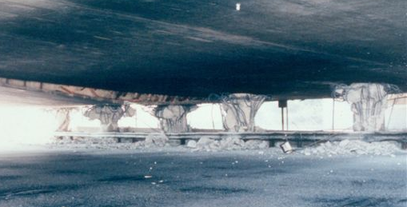
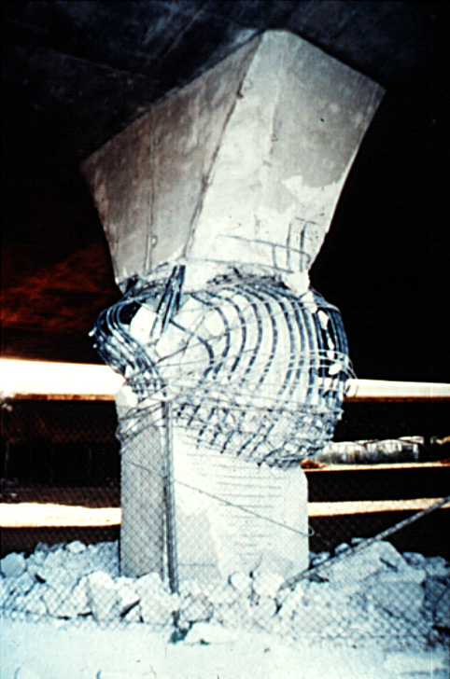
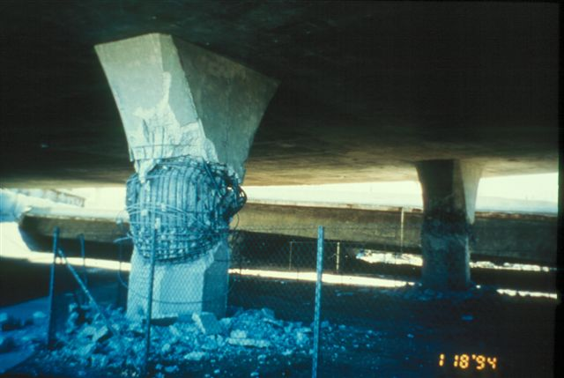
Column Damages from Earthquakes
Northridge (1/17/1994) M6.7
Notes:
These failed columns belonged to the Mission Gothic bridge. Columns were designed to develop a plastic moment hinge at the top of the column. However, due to the nonstructural flares, the effective length of the column is reduced, and the shear forces are increased. So the shear failure occurred below the flares.

Slide 5
Background
Earthquake Protection
Seismic Isolation is an effective way to protect new and old bridges
Lead-Rubber Bearings are the most widely used Base Isolators
Aging and Temperature dependency of Lead-Rubber Bearings ?
Field Experiments on Lead-Rubber Bearings
A three span continuous steel girder bridge in Western NY was seismically rehabilitated with lead-rubber bearings
Field experiments were conducted from 1994 to 1999
Seismic performance between conventional steel bearings and seismic bearings
A rare case to assess effects due to aging and temperature variations by FIELD EXPERIMENTS!

Slide 6
Basic Principles of Seismic Isolation
Basic Idea: Uncoupling a bridge superstructure from the horizontal components of earthquake ground motion
Conventional Base Isolated
Requirements of Base Isolator:
flexibility to lengthen the period of vibration of the bridge
energy dissipation
adequate rigidity for service loads
Period Shift
Damping

Slide 7
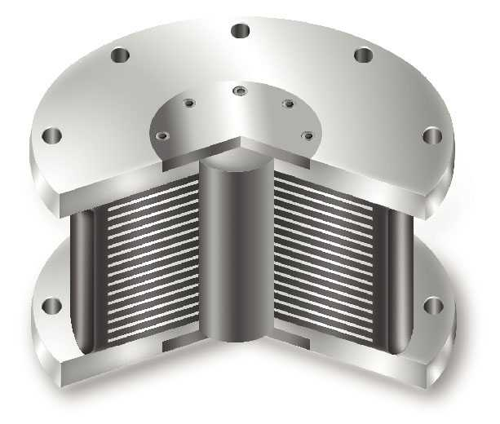
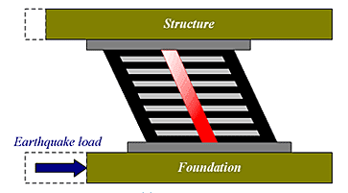
Population of Base Isolated Bridges
States with More Than Ten Isolated Bridges (2003)
State | Number of Isolated Bridges | Percentage
California | 28 | 13 %
New Jersey | 23 | 11 %
New York | 22 | 11 %
Massachusetts | 20 | 10 %
New Hampshire | 14 | 7 %
Illinois | 14 | 7 %
Other | 87 | 41 %
TOTAL | 208
Note: Isolated bridges in U.S., Canada, Mexico, and Puerto Rico
¾ of the isolated bridges in the U.S. use Lead Rubber Bearings

Slide 8
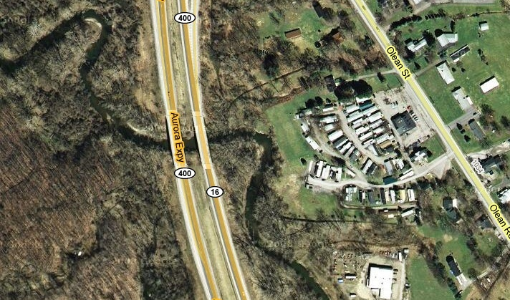
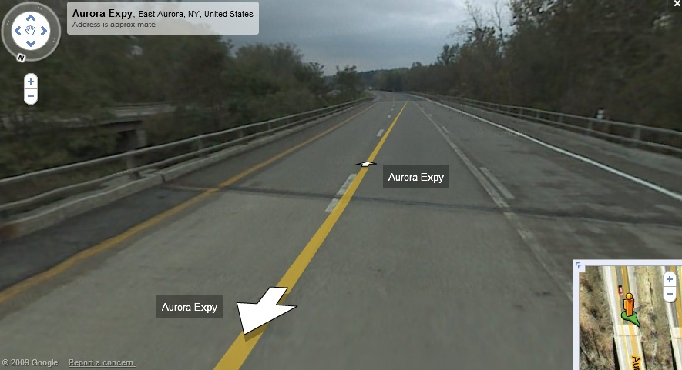
Location of the Subject Bridge
Rte 400, Western New York State

Slide 9
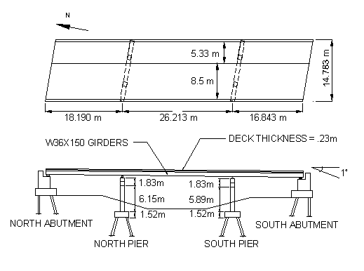
Plan and Elevation of the Subject Bridge
Girder
7 - W36x150 Steel Beam
Deck
230mm thick Conc.
Abutments
Lead Rubber Bearings
Piers
Elastomeric Bearings

Slide 10
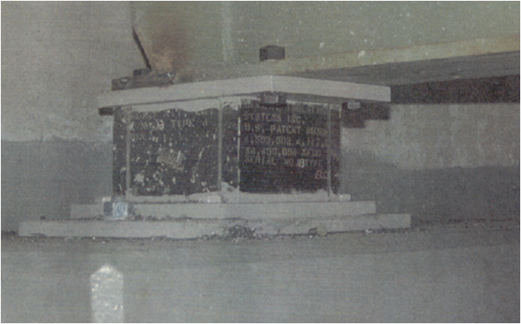
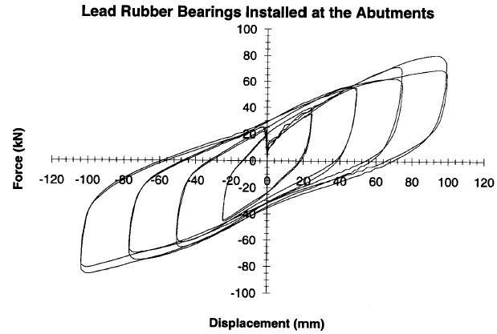
Lead Rubber Bearing
Shapes and Size
Square Shape (279mm × 279mm)
10 Rubber layers (Natural Rubber
satisfying ASTM D4014)
Lead Core Diameter : 64mm

Slide 11
Field Experiment: Pull-Back Testing
Basic Idea: a free vibration test method where lateral forces are applied to the superstructure and released quickly to introduce a free vibration
developed and applied from the 1970s
Application to base isolated bridges
Mangatewai-Iti bridge in New Zealand : Lam 1990
Four-span base isolated viaduct in Walnut Creek in California : Gilani et al. 1995
Three-span continuous PC I-girder bridge over Minor Slough in Kentucky:
Robson and Harik 1998
Three-span continuous steel-girder bridge over Cazenovia Creek :
Wendichansky et al. 1998, Hu 1998

Slide 12
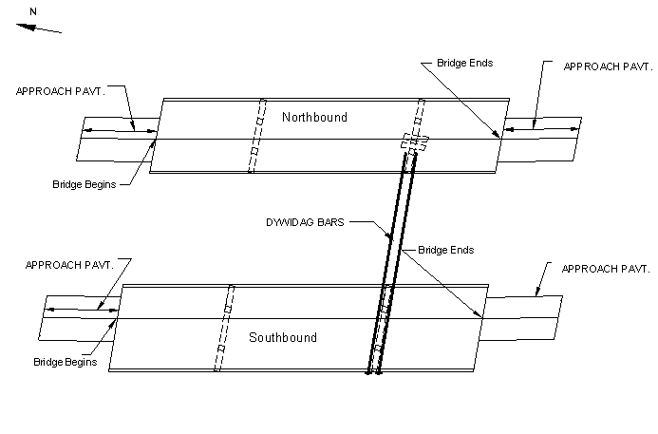
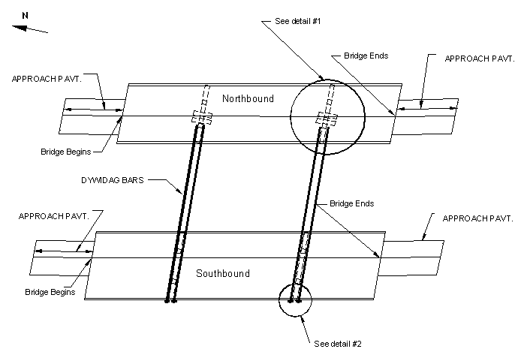
Pull-Back Testing
Two-Pier Test vs. One-Pier Test
Two-Pier Test
One-Pier Test

Slide 13
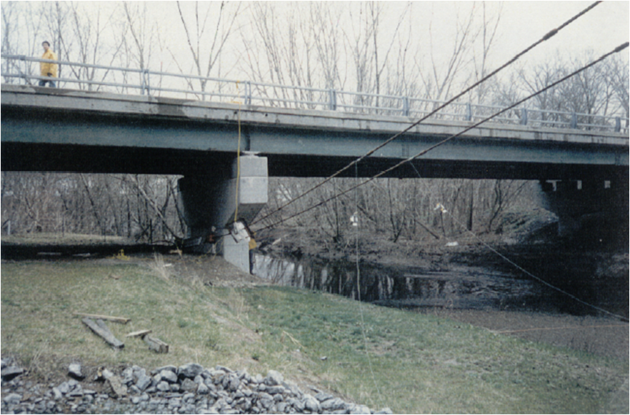
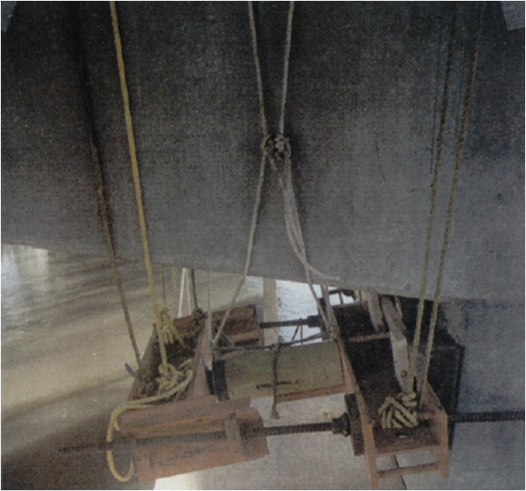
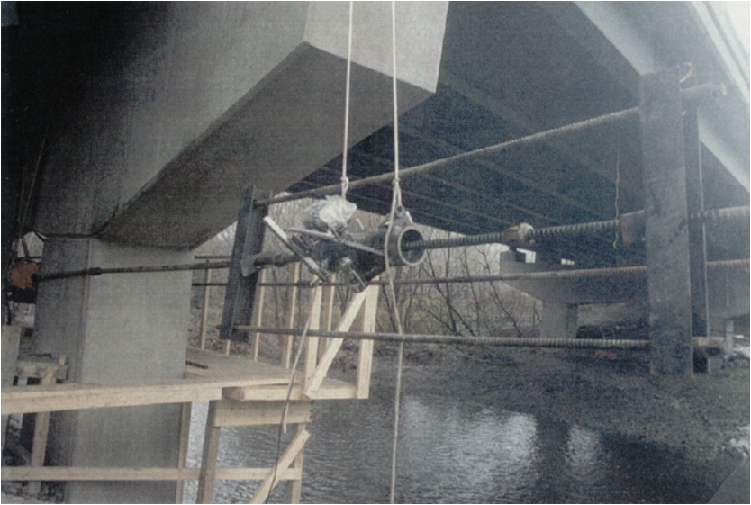
Pull-Back Testing on the Subject Bridge
Test Setting

Slide 14
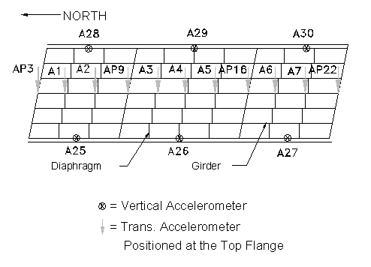
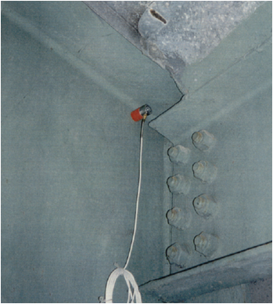
Instrumentation
Accelerometer Location (Part)

Slide 15
Pull-Back Test Summary
History
Symbol | Date | Temperature (°C) | Loading Scheme | Number of Sensors | Loading (kN)
 |  |  |  |  | N. Pier | S. Pier
QR94-1 | 10/13/1994 | 12 | TP | A:33, P:22 | 384 | 290
QR94-2 | 10/13/1994 | 17 | TP | A:33, P:22 | 555 | 520
QR94-3 | 10/13/1994 | 19 | OP | A:33, P:22 | 0 | 604
QR94-4 | 10/13/1994 | 18 | OP | A:33, P:22 | 0 | 679
QR95-1 | 4/21/1995 | 14 | OP | A:17, P:10 | 0 | 807
QR95-2 | 11/10/1995 | 9 | OP | A:17, P:10 | 0 | 663
QR95-3 | 11/10/1995 | 8 | OP | A:17, P:10 | 0 | 533
QR98-1 | 7/14/1998 | 27 | OP | A:19, P:12 | 0 | 682
QR99-1 | 1/14/1999 | -16 | OP | A:19, P:12 | 0 | 704

Slide 16
Bridge Deck Motion
Rigid Body Motion of the Superstructure

Slide 17
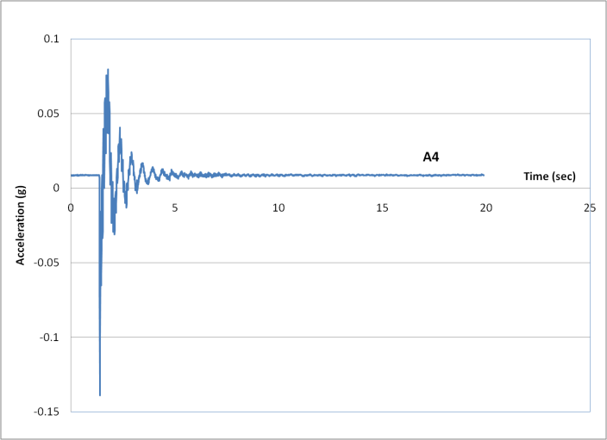
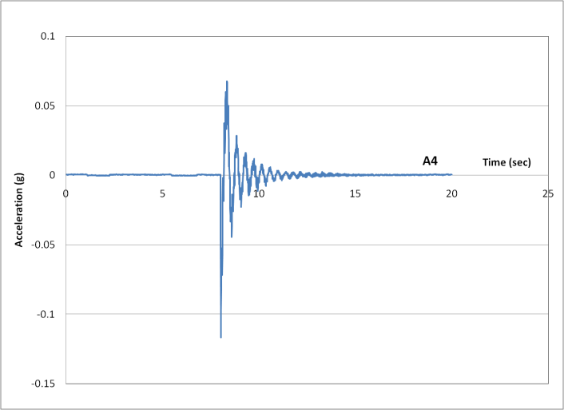
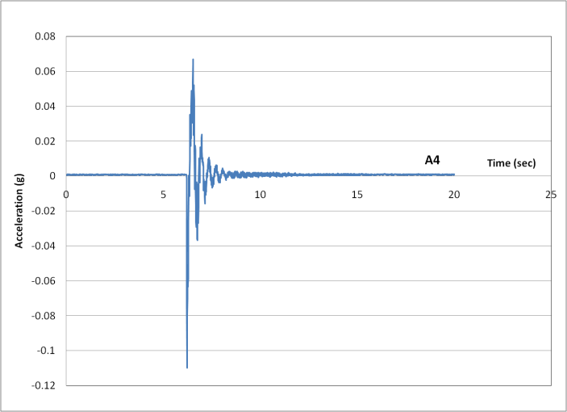
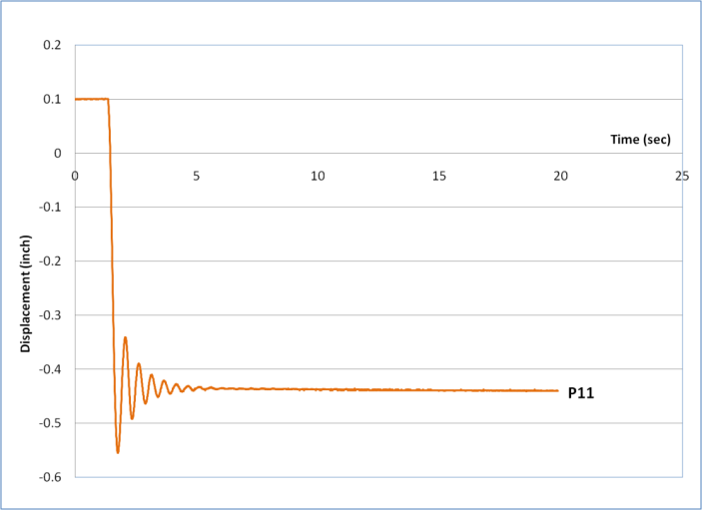
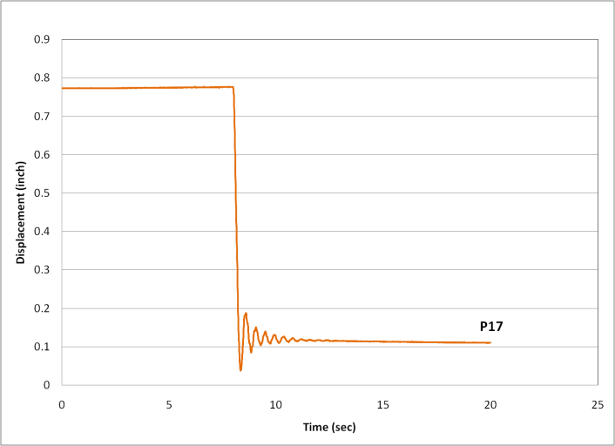
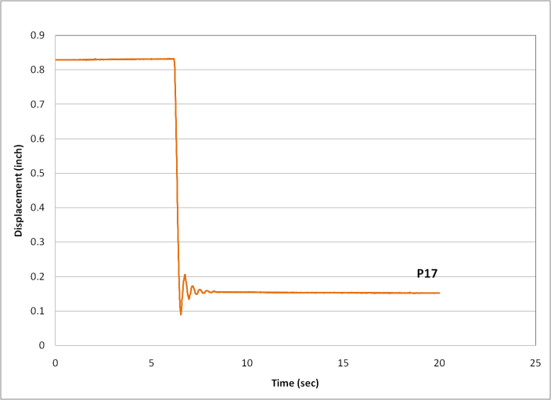
Test Results
Measured Acceleration and Displacement
QR94-3 QR98-1 QR99-1

Slide 18
System Identification
Definition:
determination of a system to which the system under test is equivalent (Åström and Eykhoff 1971)
Nonlinearity is one of the unique features and difficulties in the application of system identification to civil structures (Imai et al. 1991) :
Nonlinear Model-Based Approach
Two DOF dynamic governing equation: Transverse displacement + Rotation
Lead Rubber Bearing: Menegotto-Pinto Model
QR94-3 vs. QR98-1, QR98-1 vs. QR99-1
Issues of the subject problem
Nonlinearity
Variations among experiments
Uncertainties from expansion joint properties

Slide 19
Governing TDOF Eqn. of Bridge Deck Motion
Rigid Body Motion of the Superstructure
where
Menegotto-Pinto Model

Slide 20
System Identification Procedures
1st Phase: Superstructure Overall
Behavior
Transverse displacement and Rotation at the Center of Mass
Abutment:
∑ seven LRB + Expansion Joint
Pier:
∑ seven elastomeric bearings
+ Pier Stiffness
2nd Phase: Lead Rubber Bearing

Slide 21
System Identification (1st Phase)
System Identification → Optimization Problem:
For given models and input, the output is function of parameters in the governing equation.
System identification becomes an optimization problem to seek optimal values of the parameters to minimize the difference between measured and reproduced responses.
Optimization Formulation

Slide 22
System Identification Results (1st Phase)

Slide 23
System Identification (1st Phase)
QR94-3 vs. QR98-1
Location | Parameter | QR94-3 ⇒⇒ |  |  |  | ⇐⇐ QR98-1
 |  | Initial | 1st Trial | 2nd Trial | 3rd Trial | 3rd Trial | 2nd Trial | 1st Trial | Initial
North Abutment | F_{y} | 273.0 | 339.5 | 217.8 | 317.1 | 130.7 | 130.1 | 326.5 | 124.2
 | u_{y} | 11.56 | 15.40 | 9.04 | 11.29 | 2.57 | 2.45 | 5.90 | 2.19
 | α | 0.28 | 0.37 | 0.27 | 0.16 | 0.14 | 0.10 | 0.05 | 0.11
 | n | 11.45 | 10.00 | 9.76 | 10.00 | 2.06 | 1.76 | 1.22 | 1.49
 | ξ | 0.10 | 0.07 | 0.10 | 0.10 | 0.10 | 0.07 | 0.10 | 0.07
 | Inid' | 6.00 | 8.53 | 7.61 | 11.15 | 4.35 | 4.78 | 4.76 | 4.84
 | IniF' | 51.23 | 161.7 | 109.2 | 227.7 | 166.5 | 154.7 | 204.4 | 167.7
North Pier | k | 2.30 | 0.21 | 2.30 | 2.30 | 2.30 | 4.97 | 9.30 | 6.46
South Abutment | F_{y} | 165.9 | 95.66 | 114.1 | 154.3 | 105.4 | 140.9 | 241.9 | 149.1
 | u_{y} | 3.12 | 1.74 | 2.40 | 2.57 | 1.46 | 1.53 | 4.62 | 1.70
 | α | 0.14 | 0.18 | 0.19 | 0.13 | 0.17 | 0.11 | 0.11 | 0.11
 | n | 1.21 | 1.78 | 1.57 | 1.07 | 2.20 | 1.25 | 1.54 | 1.08
 | ξ | 0.06 | 0.10 | 0.10 | 0.07 | 0.07 | 0.10 | 0.10 | 0.10
 | Inid' | 25.62 | 23.28 | 22.81 | 23.75 | 12.94 | 12.75 | 11.98 | 12.60
 | IniF' | 13.06 | 42.66 | 24.05 | 12.50 | 4.91 | 0.00 | 14.11 | 5.75
South Pier | k | 0.89 | 0.00 | 0.10 | 0.10 | 0.10 | 0.45 | 0.80 | 0.02

Slide 24
System Identification Procedures
1st Phase: Superstructure Overall
Behavior
2nd Phase: Lead Rubber Bearing
Force-Displacement at the south abutment from the 1st phase
LRB and the Expansion Joint are separated
Uncertainty of the Expansion Joint
Measured expansion joint stiffness:
5,250 kN/m (laboratory test)
→ Random Variable

Slide 25
System Identification (2nd Phase)
Optimization Formulation
for expansion joint
Notes
force from the first phase of SI

Slide 26
System Identification (2nd Phase)
QR94-3 vs. QR98-1 (10% uncertainty range)

Slide 27
System Identification (2nd Phase)
QR98-1 vs. QR99-1 (10% uncertainty range)

Slide 28
System Identification (2nd Phase)
Randomly Selected Initial Stiffness of Expansion Joint
Repeat Optimization for Each Test
e.g. Test A and Test B
Results: Sets of Parameters for Each Test
Comparison between Two Tests
Compare Parameters:
mislead the decision on their closeness
Compare Force Responses under Test Disps.
Random Variables (Normal Distribution)
Treating Force Random Variables
Take Differences : Normal Distribution
Ensemble Average: Standard Normal Distribution
Sum of Ensemble Average: Chi-Square Distribution

Slide 29
Hypothesis Testing
Hypothesis Testing
null hypothesis: “forces from two models are the same”
calculate random variables and compare with chi-square distribution
if the hypothesis is rejected : two models are different
if it is accepted: two models are statistically indistinguishable
Hypothesis Testing Results
Comparing Case | Range of KE Changes | Summation Value | 5% Significance Level | 1% Significance Level
QR94-3 vs. QR98-1 | 10% | 49.21 | REJECT | REJECT
 | 30% | 79.13 | REJECT | REJECT
 | 50% | 67.38 | REJECT | REJECT
QR98-1 vs. QR99-1 | 10% | 52.26 | REJECT | REJECT
 | 30% | 38.20 | ACCEPT | ACCEPT
 | 50% | 42.58 | REJECT | ACCEPT

Slide 30
Identified Behavior of Lead Rubber Bearing
Force Time History Force-Displacement
Aging Effects
(QR94-3
vs.
QR98-1)
Temperature
Effects
(QR98-1
vs.
QR99-1)

Slide 31
Quantitative Comparison
Parameters | QR94-3 vs. QR98-1 |  |  | QR98-1 vs. QR99-1
 | 94 | 98 | 98/94 | 98 | 99 | 99/98
K₁ (kN/m) | 8633 | 10320 | 1.20 | 10860 | 14910 | 1.37
αK₁ (kN/m) | 761.3 | 1635 | 2.15 | 1386 | 1470 | 1.06
Energy Dissipated (N⋅m) | 1026 | 1049 | 1.02 | 1193 | 859 | 0.72

Slide 32
Results Comparison
Stiffness increases due to Aging
increased modulus of rubber
Natural aging of rubber-changes in physical properties over 40 years
by Brown and Butler
- the strength and elongation at break of rubber reduced drastically
- special attention is warranted before utilizing stiffening effects
Stiffness increases due to temperature drop:
Consistent with Lab. experiment
Energy dissipation capacity reduction due to temperature dropping:
Contradictory to the Lab. Experiment
low strain in pull-back tests
full-cycle vs. free vibration
Laboratory Test Results

Slide 33
Summary and Conclusions
A nonlinear model-based system identification method is developed and applied to the investigation of aging and temperature effects of lead-rubber bearings based on three pull-back tests of a three-span continuous bridge.
The two degree-of-freedom governing equations for transverse and rotational rigid-body motion of the superstructure can successfully capture free-vibration motion in pull-back tests.
The Menegotto-Pinto model suitably represents hysteretic damping behavior of bearings under the free-vibration condition.
In order to investigate aging and temperature dependent effects of bearings, hypothesis testing is applied to the chi-square distribution of restoring forces.
Regarding aging effects, increases of the pre-yielding stiffness and the post-yielding stiffness are observed.
Regarding temperature dropping effects, the decrease of energy dissipation capacity and the increase of the pre-yielding stiffness are observed.

Slide 34
Thank You !
Questions & Comments

Slide 36
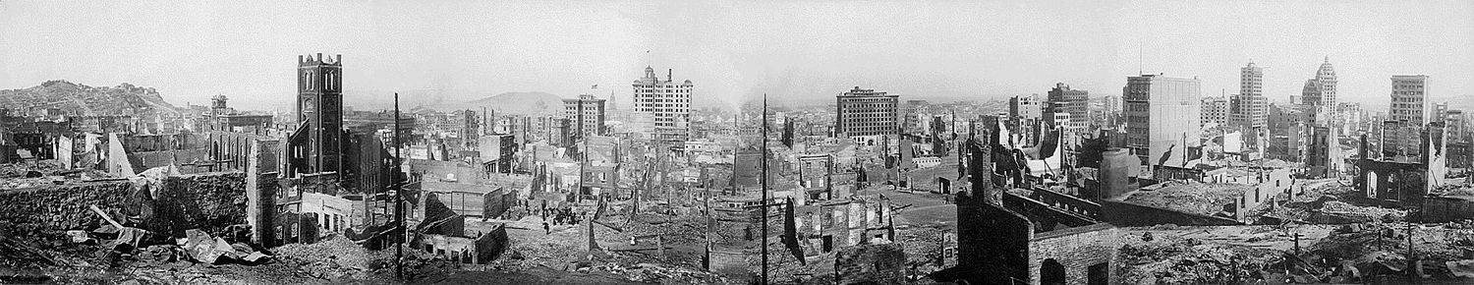
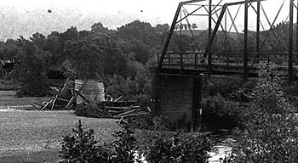
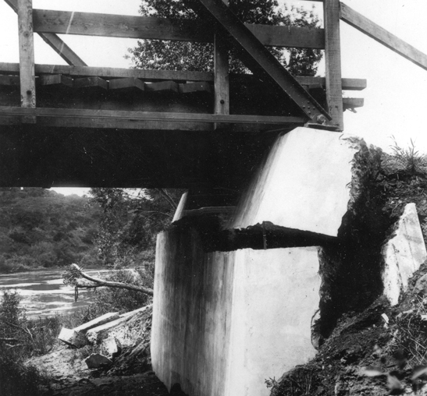
Damages on Bridges from Earthquakes
San Francisco Earthquake (4/18/1906) M7.7
Bridge in Alexander Valley

Slide 37
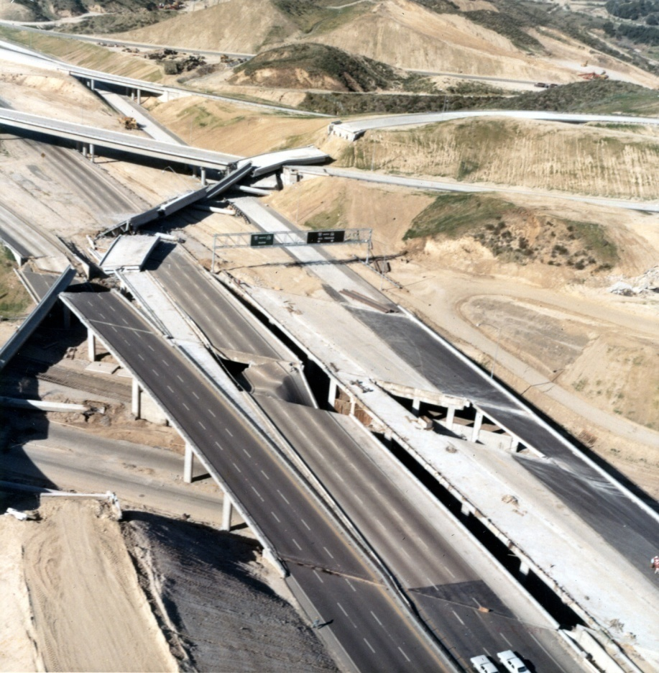
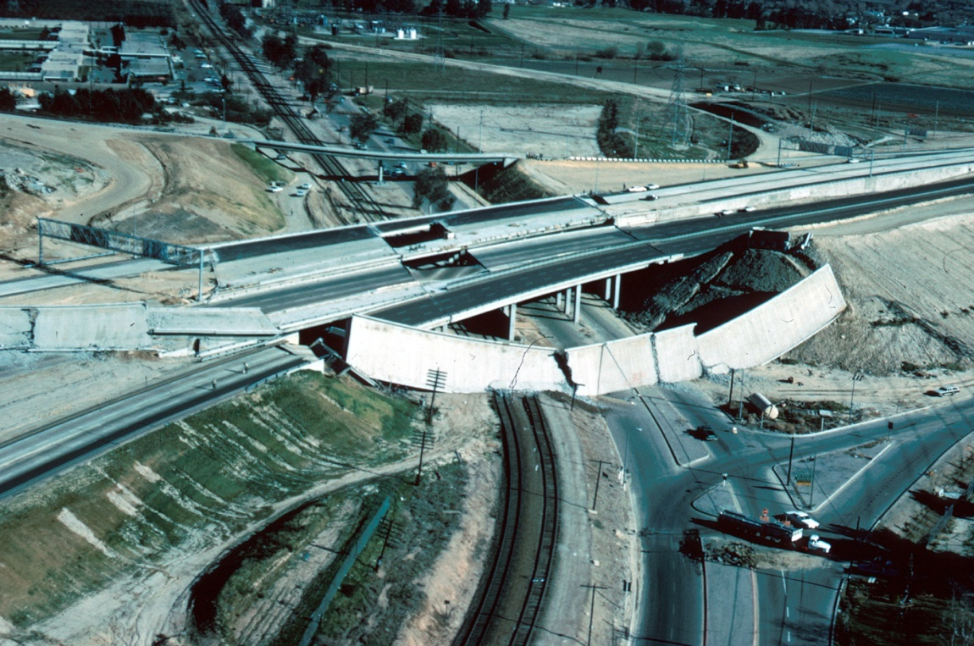
Damages on Bridges from Earthquakes
San Fernando (2/9/1971) M6.6
Interchange on Interstate Highways 5 and 210
Notes:
On February 9, 1971, San Fernando Earthquake hit southern California.
At the interchange on Interstates 5 and 210, over- passes and bridges were collapsed. Interstate 5 is the principal highway link between northern and southern California. Because of this collapse, traffic had to be re-routed for several months.

Slide 38
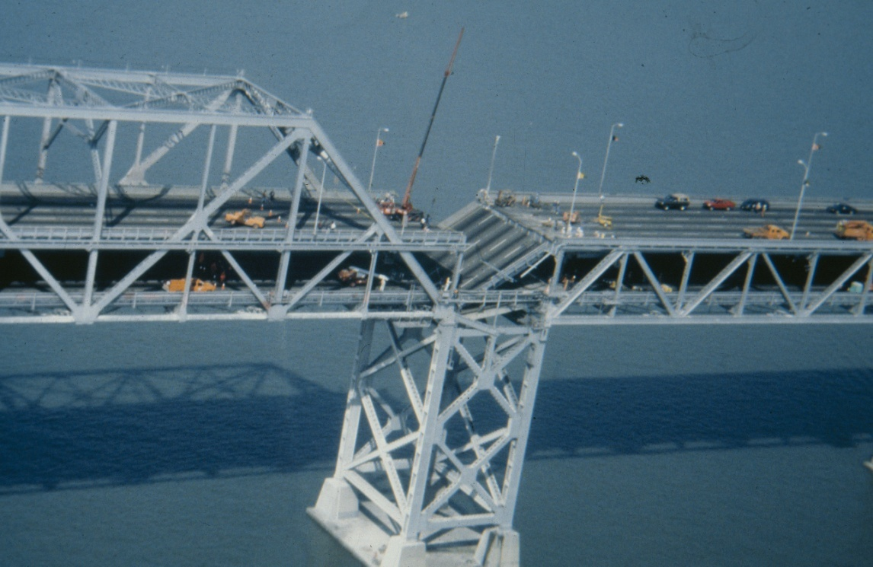
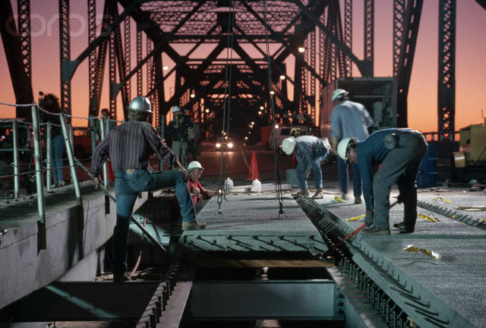
Damages on Bridges from Earthquakes
Loma Prieta (10/17/1989) M7.1
Oakland Bay Bridge
Notes:
A single span of the Oakland Bay bridge dropped, and this scene was broadcasted all over the world. In fact, the engineers who designed the bridge allowed this portion to collapse in the event of a major earthquake so that the entire structure would not be torn down. After the earthquake, the deck was repaired in 28 days.

Slide 39
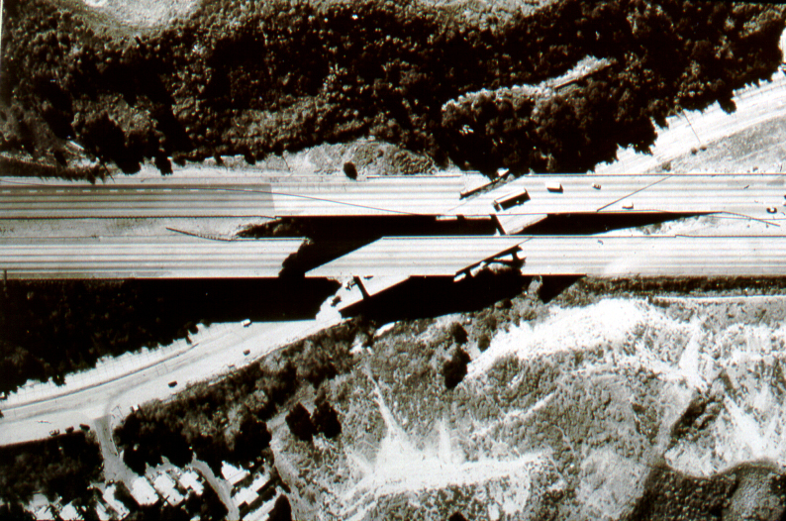
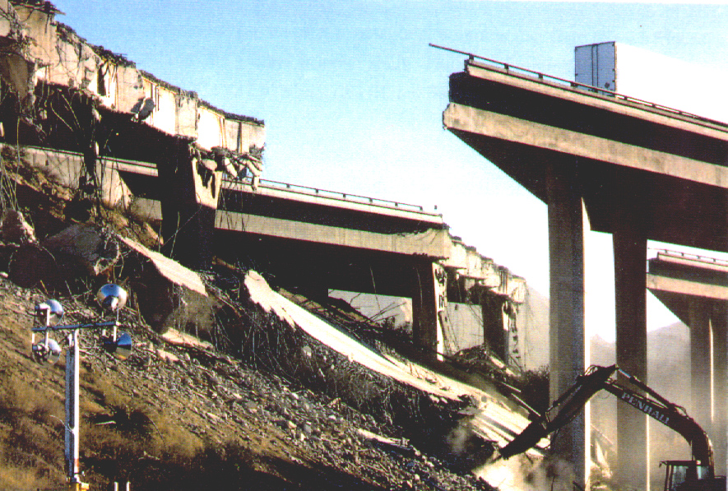
Damages on Bridges from Earthquakes
Northridge (1/17/1994) M6.7
Interchange on Interstate Highways 5 and 14
Notes:
The Northridge earthquake hit California on Jan. 17, 1994, with magnitude of 6.7.
This is an aerial view of the collapsed freeway interchange on interstate highways 5 and 14. Two sections fell down, and there were displacements of several inches between some spans in the remaining structures.

Slide 40
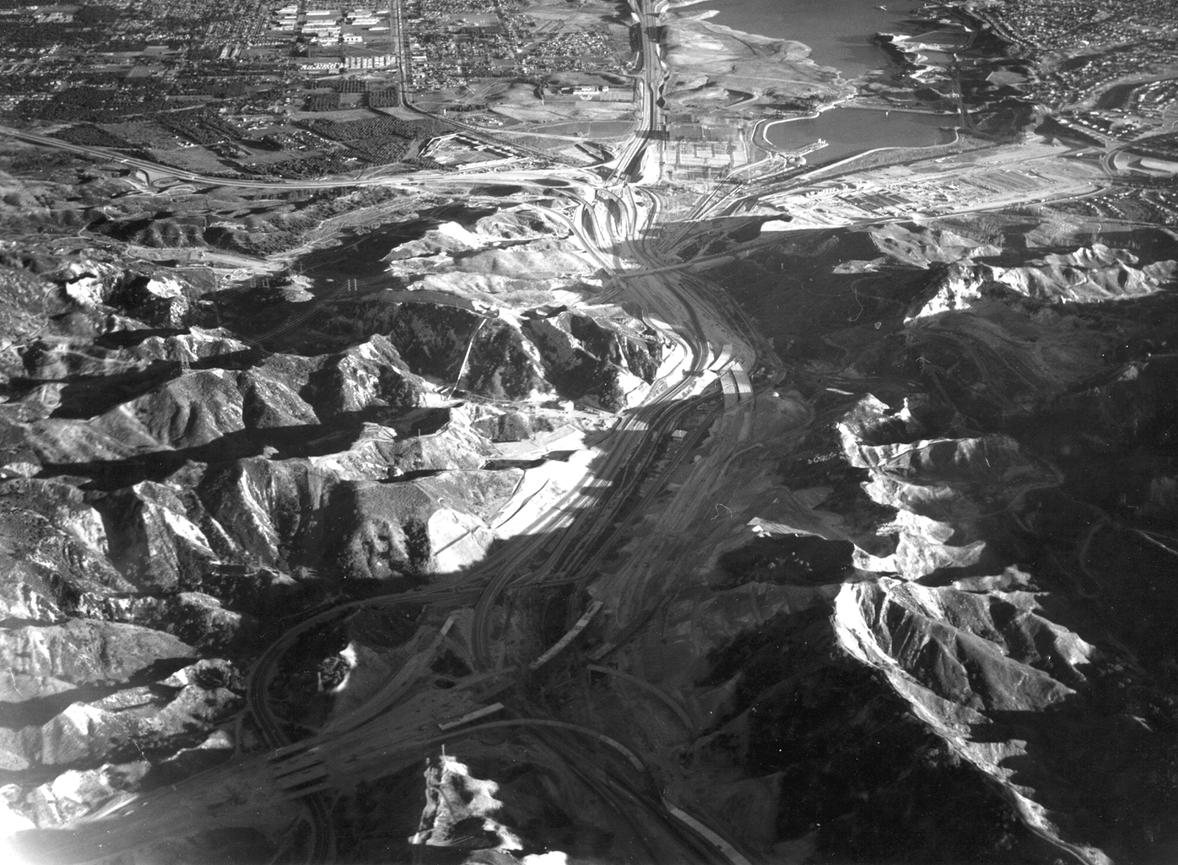
Damages on Bridges from Earthquakes
San Fernando (2/9/1971) M6.6
Notes:
On February 9, 1971, San Fernando Earthquake hit southern California.
This aerial view was taken along HIGHWAY 5. The interchange of HIGHWAYS 5 and 14 in foreground was under construction. The overpasses were incomplete at the time of the earthquake and did not collapse. Interchange of HIGHWAYS 5 AND 210 in middleground was completed but not yet in use.

Slide 41
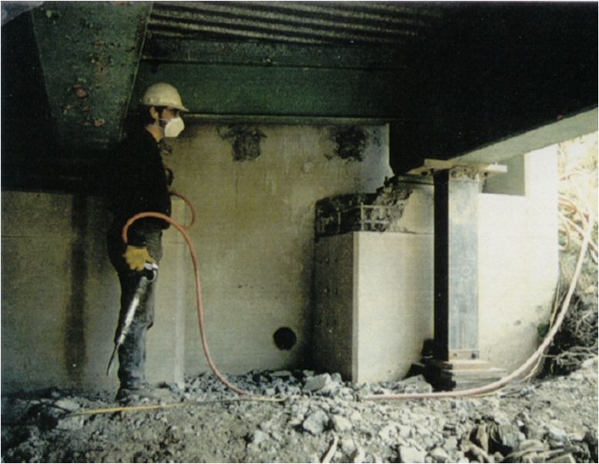
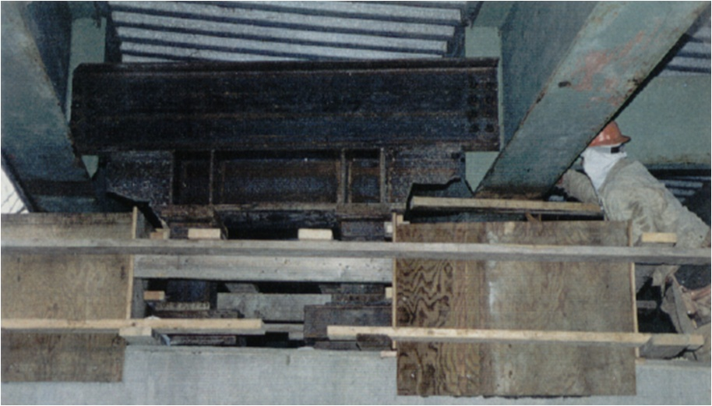
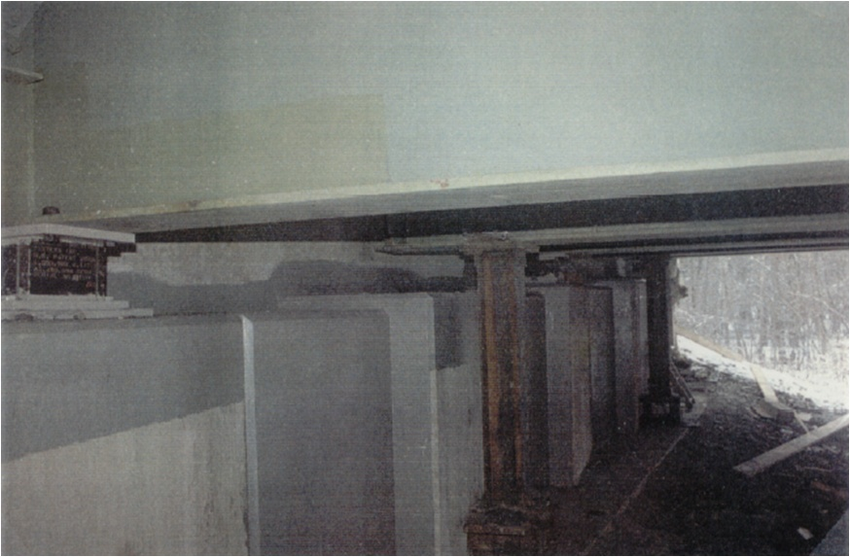
LRB Installation Works
Installation Process

Slide 42
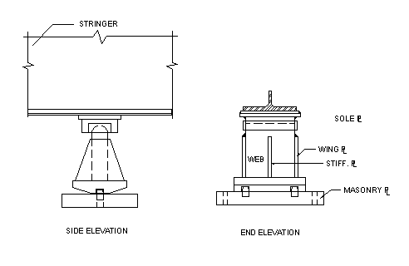
Rehabilitation History
Purposes of the Rehabilitation
Seismic Retrofit
Concrete Deck Replacement
Procedures of the Seismic Retrofit
Laboratory bearing test
Bearing replacement
In-Situ bridge tests: Pull-back test

Slide 43
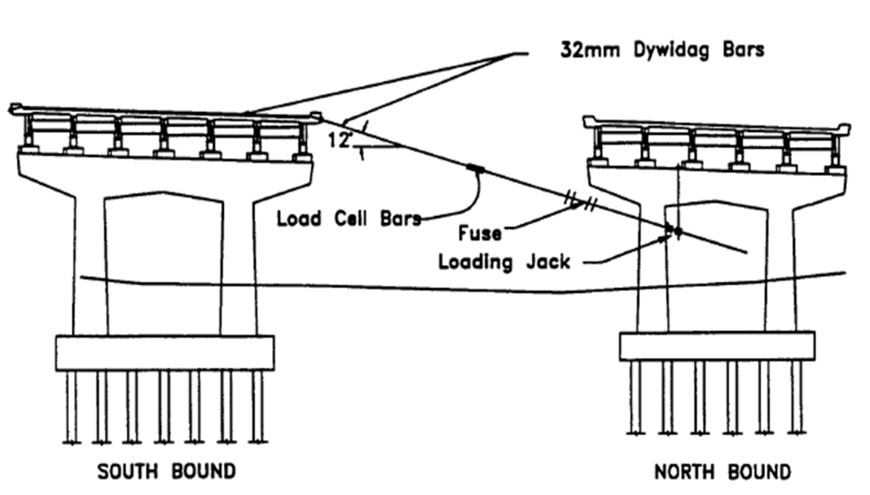
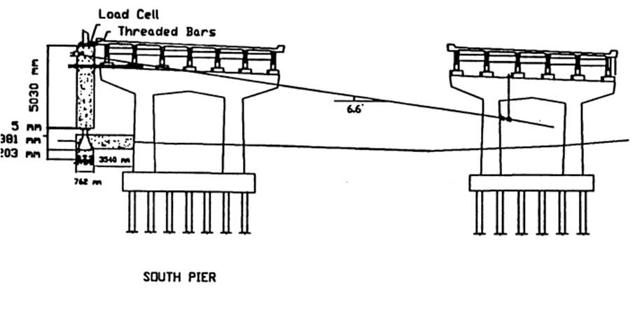
Pull-Back Testing
Over Deck Test vs. Under Deck Test
Over Deck Test
Under Deck Test

Slide 44
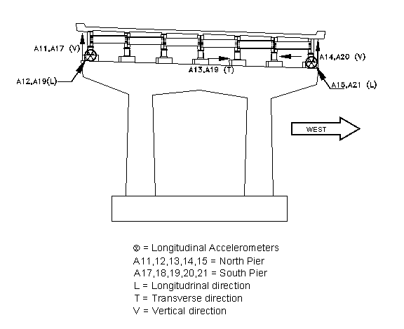
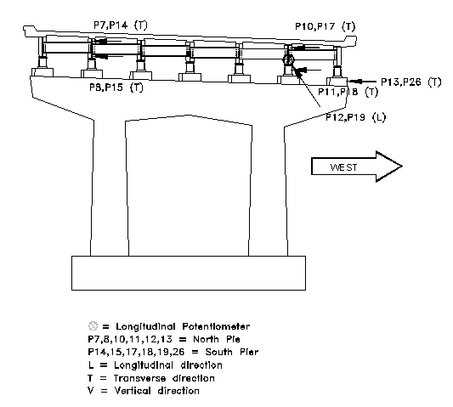
Instrumentation
Accelerometers and Potentiometers at Piers and Abutments
Accelerometers
Potentiometers

Slide 45
Hysteretic Damping Model of LRB
Menegotto-Pinto Model
Restoring force
Displacement
Force and Disp. at direction changing point
Post-yielding stiffness / Pre-yielding stiff
Force and Disp. at the yield point
for initial loading
for unloading and reloading

Slide 46
Nondimensional Combined Governing EQ.
Nondimensional Variables
Transverse displacement :
where
Rotational displacement :
Max. measured disp.
Force at uo
Radius of gyration
Time :
Nondimensional Combined Governing Equations
where

Slide 47
System Identification Post-Processing
QR98-1 vs. QR99-1
Location | Parameter | QR98-1 ⇒⇒ |  |  |  | ⇐⇐ QR99-1
 |  | Initial | 1st Trial | 2nd Trial | 3rd Trial | 3rd Trial | 2nd Trial | 1st Trial | Initial
North Abutment | F_{y} | 124.2 | 115.3 | 137.7 | 131.4 | 514.4 | 558.4 | 429.4 | 572.9
 | u_{y} | 2.19 | 2.45 | 2.23 | 2.29 | 5.18 | 4.48 | 3.89 | 4.61
 | α | 0.11 | 0.15 | 0.08 | 0.10 | 0.07 | 0.01 | 0.07 | 0.01
 | n | 1.49 | 1.73 | 1.76 | 1.89 | 1.12 | 1.01 | 1.28 | 1.00
 | ξ | 0.07 | 0.10 | 0.10 | 0.10 | 0.10 | 0.10 | 0.10 | 0.09
 | Inid' | 4.84 | 5.47 | 3.17 | 3.87 | 2.41 | 3.03 | 2.60 | 1.98
 | IniF' | 167.7 | 192.5 | 89.77 | 124.2 | 196.3 | 281.5 | 231.0 | 158.2
North Pier | k | 6.46 | 5.31 | 0.20 | 0.05 | 0.05 | 0.05 | 0.43 | 0.06
South Abutment | F_{y} | 149.1 | 124.2 | 123.7 | 128.7 | 93.35 | 101.2 | 88.84 | 112.8
 | u_{y} | 1.70 | 1.29 | 1.99 | 1.69 | 0.90 | 1.29 | 1.09 | 1.34
 | α | 0.11 | 0.11 | 0.18 | 0.14 | 0.12 | 0.14 | 0.14 | 0.12
 | n | 1.08 | 1.31 | 2.03 | 1.72 | 1.15 | 1.20 | 1.17 | 1.02
 | ξ | 0.10 | 0.10 | 0.10 | 0.08 | 0.08 | 0.10 | 0.10 | 0.09
 | Inid' | 12.60 | 12.92 | 12.91 | 12.96 | 11.87 | 11.90 | 11.81 | 11.90
 | IniF' | 5.75 | 2.78 | 14.41 | 2.22 | 0.00 | 6.28 | 3.67 | 0.00
South Pier | k | 0.02 | 0.44 | 0.05 | 0.05 | 0.05 | 0.05 | 0.45 | 0.06

Slide 48
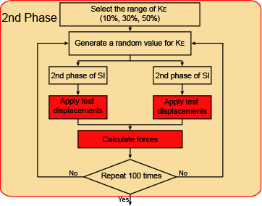
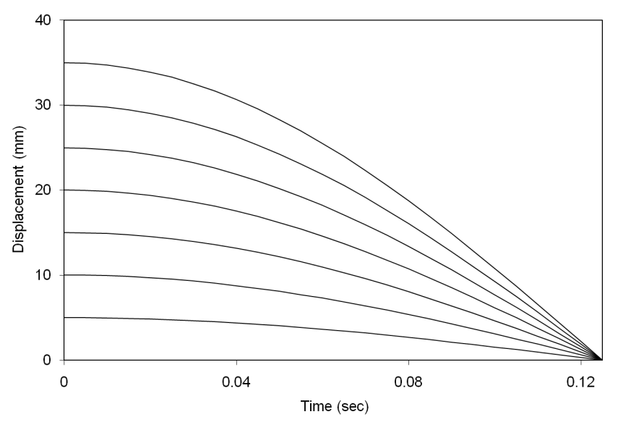
System Identification (2nd Phase)
Test Displacement Functions
Seven (j=1-7) displacement function
Max Amplitude 5 mm – 35 mm
Period : 0.5 sec (i=26 data points)
Forces at data point i under test displacement j
For Test A
For Test B

Slide 49
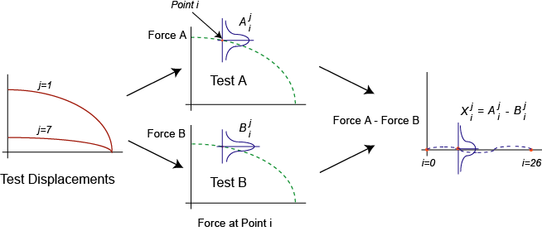
System Identification (2nd Phase)
Forces at data point i under test displacement j
For Test A
For Test B

Slide 50
System Identification (2nd Phase)
Probability Distribution (comparison between Test A and Test B)
the random variable has
if two means are the same and the s.t.d is a constant, then
the standard normal distribution becomes

Slide 51
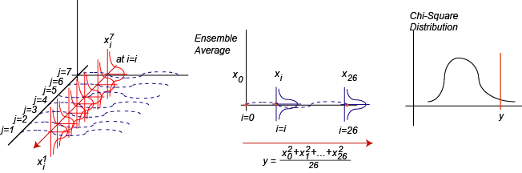
Uncertainty Consideration in SI
Ensemble Average (comparison between Test A and Test B)
taking average of x by seven test displacements at point i
Chi-square distribution
the sum of the square of makes a chi-square distribution, i.e.

Slide 52
Current Design Practice
AASHTO Guide Specifications for Seismic Isolation Design
Developed at MCEER, University at Buffalo
Minimum Modification Factors
Maximum Modification Factors
 | Qd | Kd | Note
λtemperature | 1.4 | 1.1 | LDRB, temperature = -10 °C
λaging | 1.1 | 1.1 | LDRB

